Slide 1

Safeguarding Raising Awareness of
Domestic Abuse
Welcome

Slide 2
Some starting points…
A
Other devices off/away please
Drinks/comfort breaks
Bathroom
Fire exits
Participate and allow others to do so
Notes:
Some starting points:
Go through the domestic information
Introduce some simple rules for the event - ask people agree and add as others as required.
Balanced participation
Speaking for ourselves
Switch off mobiles and iPads (unless these are being used directly in the sessions)
Confidentiality - Explain that we will not be sharing confidential material, though all of the stories and studies are based on real situations. There is no expectation that they will share anything personal to them or to others, but some may choose to in the course of the session. In that event, ensure an agreement of confidentiality.

Slide 3




Advance Warning and Guidance
The subject matter of this course may cause you to feel upset or distressed.
Take a break.
Seek support from someone you trust.
If needed, contact the appropriate person in your setting or emergency service.
Notes:
Advance Warning and Guidance
Difficult material - if you are uncomfortable, let the trainer know that you need a moment etc. Explain that any of us may find the material covered upsetting– if that is the case for you…. Trainer will need to add in detail of the arrangements for dealing with any disclosure during the event.
The subject matter of this course may cause you to feel upset or distressed. If this happens, you can take a break and (if needed) seek support from someone you trust.
If you have concerns about someone you know, please speak to the trainers after the session or contact your local church’s designated Safeguarding Officer, Coordinator or other Designated Person. If you believe someone is in immediate danger, dial 999 and ask for the Police.

Slide 4

Welcome from Bishop Robert (video)
https://player.vimeo.com/progressive_redirect/download/1026128656/rendition/1080p/welcome_from_bishop_robert%20%281080p%29.mp4?loc=external&signature=22de074136a3d0256f9fe822af1d2f2aee861a8b09fd3cfebeb57786d7edfb8c
Notes:
Welcome from Bishop Robert:
This video is downloadable so that it can be viewed offline.
The video contains subtitles.
TRANSCRIPT:
Let me say, first of all, a huge thank you to you for giving your time to participate in this training on raising our awareness of domestic abuse.
The sad reality is that domestic abuse is to be found right across our society. It's in the communities that we serve and it's in our parishes and chaplaincies. Domestic abuse impacts us all, women, men and children, and it can be found in relationships, be those intimate partner relationships or wider family and friendship groups.
This training is about raising our awareness of domestic abuse, and it's part of an ongoing learning journey for the whole Church as we seek to be better equipped in caring for God's people. This training certainly won't make us experts, but it will help us both in our pastoral care and in knowing when and how to access help.
So, thank you.
Jesus promises a fullness of life, and that's something that we as a church are called to share. Domestic abuse mars that fullness of life. Domestic abuse destroys life. And you're playing your part, a gospel part in standing up against domestic abuse and in changing the culture of the Church and of society. It's a really important thing that you're doing today.

Slide 5

Course aims and outcomes
Define domestic abuse and understand the range of situations that are included in its scope;
Recognise the scale of domestic abuse, who is affected and why it occurs;
Recognise the signs and patterns of domestic abuse, and why removing themselves from abusive relationships is difficult for victims/survivors;
Identify the unique challenges present in Christian communities in engaging with domestic abuse;
Apply a clear process in response to concerns about domestic abuse;
Identify some steps Christian communities can take to respond effectively to domestic abuse.
Aim: To develop a greater understanding of what domestic abuse is, who it affects, as well as its impact on individuals, children, the wider family, and the community.
Notes:
Course Aims and Outcomes (displayed on the screen).
You have been asked to take this course because your role in your church or community means you are likely to come into contact with children, young people, or vulnerable adults, or because you hold responsibilities within the leadership (e.g., PCC member, priest, LLM, PSO, youth or children’s worker) where an understanding of domestic abuse is important to support your role in developing a safer, healthier culture.
This is an awareness-level training. Its purpose is to introduce participants to key concepts related to domestic abuse by exploring six critical questions:
What is domestic abuse?
Who is most affected by domestic abuse?
What are the signs (and patterns) of domestic abuse?
Why does domestic abuse happen?
Why don't victims/survivors leave relationships with an abuser?
How can we respond to domestic abuse?
It is worth noting that 'Domestic Abuse' includes many other forms of abuse that you may have already learned about in the NST Basic Awareness and Foundations courses
It is likely that you may develop concerns about domestic abuse due to signs of one or more of these forms of abuse, so being able to recognise them is crucial.
At various stages throughout this course, you will be asked to answer several questions designed to assess your understanding of the material presented.

Slide 6
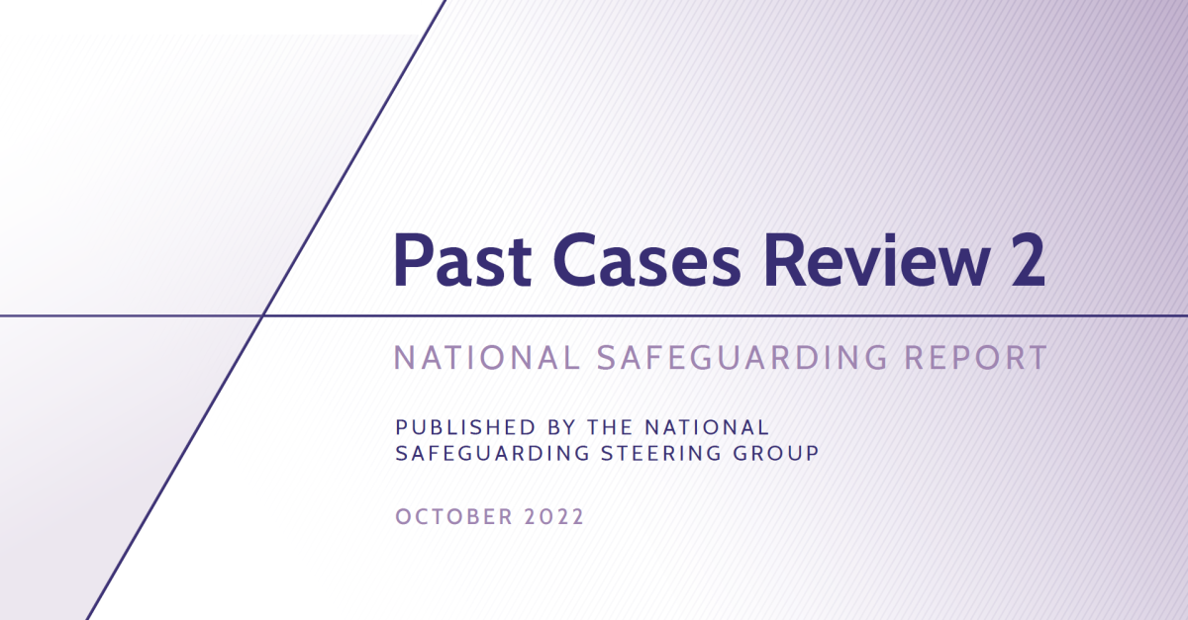
Background
Notes:
Background
The Past Cases Review 2 (PCR2; 2022) conducted by the Church of England aimed to review the handling of safeguarding cases in the church over many years, with a focus on identifying good practices and areas for improvement.
Amongst the findings of the review, the reviewers cited that:
“Many non-recent examples indicated a limited understanding of domestic abuse amongst church officers that at the time resulted in limited recognition and response to issues and poor management of perpetrators.
There was a view that not enough had been done to ensure staff and clergy were sufficiently aware to recognise the signs of domestic abuse, or the confidence to get involved to help stop it.
This further impacted on survivors and victims, with little thought given to their ongoing needs, especially when there was no wish to pursue a formal complaint.”
PCR2, Page 105
One recommendation from reviewers was:
“All church bodies to raise awareness of domestic abuse, including the understanding of the harmful impact of domestic abuse on children.”
(Recommendation 26)
This training pathway is part of the Church of England’s response to this recommendation.

Slide 7

Defining domestic abuse
"Any incident or pattern of incidents of controlling, coercive, threatening behaviour, violence or abuse between those aged 16 or over who are, or have been, intimate partners or family members regardless of gender or sexuality. The abuse can encompass, but is not limited to, psychological, physical, sexual, financial or emotional abuse.”
Domestic Abuse Act 2021
Notes:
Defining Domestic Abuse
The UK government’s definition of domestic abuse is as follows:
“Any incident or pattern of incidents of controlling, coercive, threatening behaviour, violence or abuse between those aged 16 or over who are, or have been, intimate partners or family members regardless of gender or sexuality. The abuse can encompass, but is not limited to, psychological, physical, sexual, financial or emotional abuse.”
Domestic Abuse Act 2021
Within this definition, ‘family members’ are defined as: mother, father, son, daughter, brother, sister and grandparents, whether or not directly related, in-laws or step-family.
So, in addition to common assumptions (both about the context and the perpetrator), this also includes:
Any type of romantic, sexual, or marital relationship where one party is abused by the other, whether it be within the same household or not.
Any situation where a child over the age of 16 is subjecting any other family member over the age of 16 (including a parent or guardian) to abuse.
Any situation that includes so-called ‘honour’-based violence, female genital mutilation (FGM), or forced marriage.
It is important to recognise that anybody can be a victim or a perpetrator of domestic abuse.
Now let’s unpack some of the key features of this definition.

Slide 8

Children and young people
Young people aged 16 and over can experience domestic abuse, either as victims or perpetrators. (Domestic Abuse Act 2021)
Therefore, domestic abuse issues involving 16/17 year olds are also treated as a child safeguarding concern.
Children who live in a home where domestic abuse occurs are considered victims, even if the abuse is not directed at them.
Both witnessing domestic abuse or experiencing direct abuse carry serious risks of significant harm.
Notes:
Children and Young People
Under the Domestic Abuse Act 2021, young people aged 16 and over can legally be recognised as victims or perpetrators of domestic abuse within their own relationships.
However, the Children Act 1989 still classifies anyone under the age of 18 as a child.
This means that if a 16 or 17 year old is in an abusive relationship, they are not only experiencing domestic abuse but are also considered a child in need of protection. As a result, such situations must be treated as both a domestic abuse issue and a child safeguarding concern, ensuring the young person receives the appropriate support and intervention.
Additionally, all children who live in a home where domestic abuse takes place are also regarded as victims - even if the abuse is not directed at them.
The Adoption and Children Act 2002 updated the definition of "harm" in the Children Act to reflect this. It clarifies that when a child sees or hears someone else being abused, it can damage their health or development -and this is also recognised as harm.
Therefore, children can be victims of domestic abuse either as direct recipients of the abuse or as witnesses to it.
In either case, there are serious risks of significant harm to both children and young people.

Slide 9
Understanding coercion and control
'Controlling behaviour' refers to a range of acts designed to make a person subordinate and/or dependent.
'Coercive behaviour' involves an act or a pattern of acts such as assault, threats, humiliation, intimidation, or other abuse.
'Coercive control' is a term used to describe extreme psychological and emotional abuse.
(Serious Crime Act, 2015)
Notes:
Understanding Coercion and Control
In 2015, the government created a new offence: Coercive or Controlling Behaviour.
Controlling behaviour refers to a range of acts designed to make a person subordinate and/or dependent by isolating them from sources of support, exploiting their resources and capacities for personal gain, depriving them of the means needed for independence, resistance, and escape, and regulating their everyday behaviour.
Coercive behaviour involves an act or a pattern of acts such as assault, threats, humiliation, intimidation, or other abuse used to harm, punish, or frighten the victim.
As stated in the UK government’s definition of abuse, these offences are always a component of domestic abuse.
Coercive control is a term used to describe extreme psychological and emotional abuse, where the victim feels isolated, intimidated, and fearful.
It can include:
Making unreasonable demands
Monitoring their whereabouts using GPS and constantly checking up on them
Isolating them from friends and family
Putting them down in front of others
Forcing them to commit crimes
Threatening them, their family, or pets
Stalking behaviours

Slide 10

Culturally or religiously motivated domestic abuse
Domestic abuse is included in the broader category of Violence Against Women and Girls (VAWG).
Examples of culturally or religiously motivated domestic abuse include:
Forced marriage.
Female genital mutilation (FGM).
So-called “honour-based" abuse.
These acts are usually committed by family members.
Those involved may not recognise or accept that these actions are crimes.
(Men can also be victims of honour-based abuse and forced marriage.)
All of these are criminal offences.
Notes:
Culturally or religiously motivated domestic abuse
Domestic abuse is included in the broader category of Violence Against Women and Girls (VAWG).
VAWG is an umbrella term used to describe acts of violence that are primarily - though not exclusively - committed against women and girls because of their gender.
It includes a wide range of abuse, including forms of family violence found within the UK’s definition of domestic abuse, such as:
· Forced marriage
· Female genital mutilation (FGM)
· So-called “honour-based" abuse
It is important to note that men can also be victims of honour-based abuse and forced marriage, although the majority of cases involve women and girls.
These acts are usually committed by family members.
The perpetrators - and sometimes even the victims - may not recognise or accept that these actions are crimes, but UK law is very clear: all of these are criminal offences.
These forms of abuse may be unfamiliar to many of us. Let’s now explore them in more detail.

Slide 11

Forced marriage
Forced marriage occurs when someone is made to marry against their will, usually by parents, family members, or religious leaders.
Forced marriage is distinct from arranged marriage.
Forced marriage is not limited to a single country or culture.
Men can also be victims of forced marriage, although this is less common.
Notes:
Forced Marriage
Forced marriage occurs when someone is made to marry against their will, usually by parents, family members, or religious leaders. If they resist, victims may be subjected to threats, physical or sexual violence, and emotional or psychological coercion.
Forced marriage is distinct from arranged marriage. In an arranged marriage, family members may suggest a partner, but both individuals have the autonomy and right to consent. Arranged marriages occur in many cultures.
Forced marriage is not limited to a single country or culture.
The Forced Marriage Unit (FMU) has dealt with cases connected to over 100 countries across Asia, the Middle East, Africa, Europe, and North America.
Most forced marriages involving British nationals occur abroad.
In 2022, the Marriage and Civil Partnership (Minimum Age) Act came into force, raising the minimum legal age for marriage in England and Wales to 18 and making it a crime to facilitate the marriage of anyone under that age.
In 2023, there were 280 confirmed cases of forced marriage and 519 enquiries to the FMU.
Most victims were under the age of 25, however, forced marriage is often referred to as a “hidden crime” meaning that the true number of victims is likely much higher than reported.
Men can also be victims of forced marriage, although this is less common.

Slide 12

Female Genital Mutilation (FGM)
FGM involves the deliberate cutting of female genitals for non-medical reasons. It has been illegal in the UK since 1985.
Justifications include beliefs about:
Cleanliness;
Religious obligation;
Maintaining chastity;
Protecting family honour;
Improving marriage prospects.
FGM is often performed in secret, in unsterile conditions, and can lead to illness or death.
FGM is practiced in at least 29 countries in the world, in addition to diaspora communities in Europe including the UK.
37,615 cases of FGM were identified between April 2015 and March 2024. (NHS)
Notes:
Female Genital Mutilation (FGM)
FGM involves the deliberate cutting of female genitals for non-medical reasons.
Justifications often include beliefs about cleanliness, religious obligation, maintaining chastity, protecting family honour, or improving marriage prospects.
FGM is often performed in secret, in unsterile conditions, and can lead to serious health issues - even death.
When performed on girls, it is a form of child abuse. It has been illegal in the UK since 1985, and offenders can face up to 14 years in prison. There are no health benefits, and the practice is recognised internationally as a violation of human rights.
FGM is practiced in at least 29 countries across West, East, and North-East Africa, as well as in some parts of the Middle East and Asia. It is also present among diaspora communities in Europe, including the UK.
According to NHS data, 37,615 cases of FGM were identified between April 2015 and March 2024.
In 2023–24 alone, 6,655 individual women and girls accessed NHS services where FGM was identified. Over three-quarters of these cases involved girls aged 10 or under, and the vast majority involved victims being taken overseas to undergo the procedure.
An estimated 60,000 girls under the age of 15 in the UK are at risk of this type of family violence.
In 2023, the FMU received 802 contacts related to possible forced marriage and/or FGM, indicating a strong link between the two practices.

Slide 13

So called “Honour-based" abuse
Honour-based' abuse is a form of domestic abuse carried out to protect the so-called “honour” of a family or community.
Those who violate these unwritten rules are punished.
‘Honour-based’ crimes may include:
Murder
Forced marriage
Domestic violence
Sexual violence
Threats to kill
Pressure to travel or move abroad
House arrest and restricted freedom
Isolation from family and friends
People may be targeted for ‘honour-based’ punishment for:
Seeking a divorce or separation.
Starting a new relationship.
Talking to or socialising with members of the opposite sex.
Having relationships or marrying outside their religion.
Engaging in sex before marriage.
Choosing their own marriage partner.
Attending college or university.
Expressing a sexual identity deemed culturally unacceptable.
Notes:
So-called “Honour-Based” Abuse
'Honour-based' abuse is a form of domestic abuse carried out to protect the so-called “honour” of a family or community.
This “honour” is typically defined by male family members, and those - often
women or girls - who violate these unwritten rules are punished for allegedly bringing shame upon the family.
‘Honour-based’ crimes are most prevalent within diaspora communities from South Asia, the Middle East, and North and East Africa, and may include:
Murder
Forced marriage
Domestic violence
Sexual violence
Threats to kill
Pressure to travel or move abroad
House arrest and restricted freedom
Isolation from family and friends
People may be targeted for honour-based punishment for:
Seeking a divorce or separation
Starting a new relationship
Talking to or socialising with members of the opposite sex
Having relationships or marrying outside their religion
Engaging in sex before marriage
Choosing their own marriage partner
Attending college or university
Expressing a sexual identity deemed culturally unacceptable

Slide 14
Summing up
Domestic abuse refers to a relational context in which abusive behaviour takes place in one or more forms.
Domestic abuse also involves specific dynamics of power and control.
Some cultural or religious practices are considered criminal offences under UK law and are included within the legal definition of domestic abuse.
Notes:
Summing Up
Domestic abuse refers to a relational context in which abusive behaviour takes place in one or more forms.
However, it is important to recognise that domestic abuse also involves specific dynamics of power and control, which we will explore further in this course.
Additionally, some cultural or religious practices are considered criminal offences under UK law and are included within the legal definition of domestic abuse

Slide 15

Review your learning: Part 1 – Question 1 of 3
Which of the following would be considered domestic abuse under the UK government's definition?
Choose 3 from the following:
An 18-year-old woman marrying abroad.
A 17-year-old boy threatening and physically assaulting his stepfather.
A woman being isolated from friends by her husband and having her spending controlled.
A man being monitored and humiliated by his boyfriend through constant messages and GPS tracking.
Notes:
Correct answers will be displayed on click.

Slide 16
Review your learning: Part 1 – Question 2 of 3
Which of the following are examples of coercive or controlling behaviour as defined by UK law?
Choose 3 from the following:
Isolating someone from friends and family.
Threatening to harm a pet to gain compliance.
Frequently texting a partner to ask how their day is going.
Making someone commit a crime under duress.
Notes:
Correct answers will be displayed on click.

Slide 17
Raising Awareness of Domestic Abuse
Review your learning: Part 1 – Question 3 of 3
Which of the following are considered criminal offences related to culturally or religiously motivated
family violence under UK law?
Choose 3 from the following:
Practising female genital mutilation (FGM).
Prohibiting a child from attending school for religious reasons.
Forcing a woman to remain in the house to avoid "shaming" the family.
Encouraging a 16-year-old to marry to secure family honour.
Notes:
Correct answers will be displayed on click.

Slide 18

Introduction to Part 2: The statistical picture
Domestic abuse is widespread in society and is not limited to a particular section of the population, nor determined by gender, ethnicity or religion.
Notes:
The Statistical Picture
We know that domestic abuse is widespread in society.
It is not limited to a particular section of the population, nor determined by gender, ethnicity or religion.
We will spend some time now looking at the statistical picture around domestic abuse.
This will provide an understanding about its prevalence and widespread nature.

Slide 19
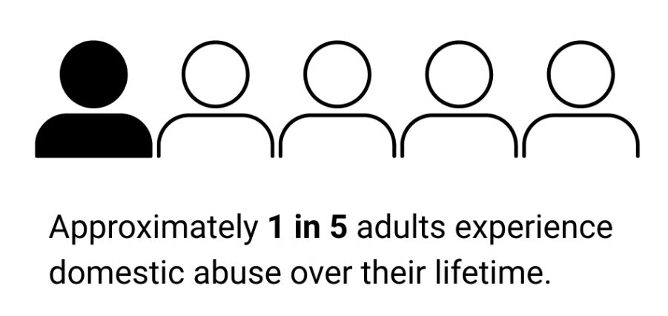
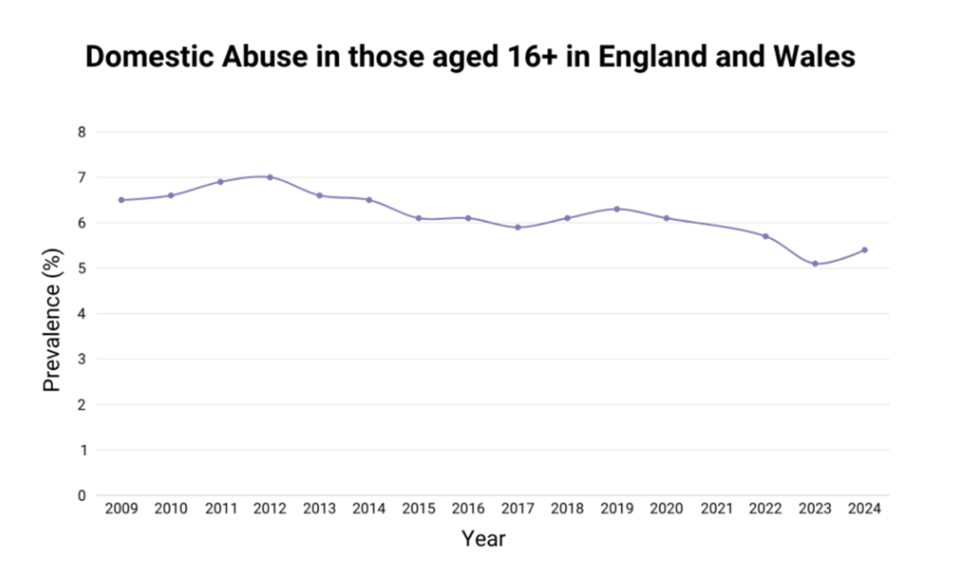
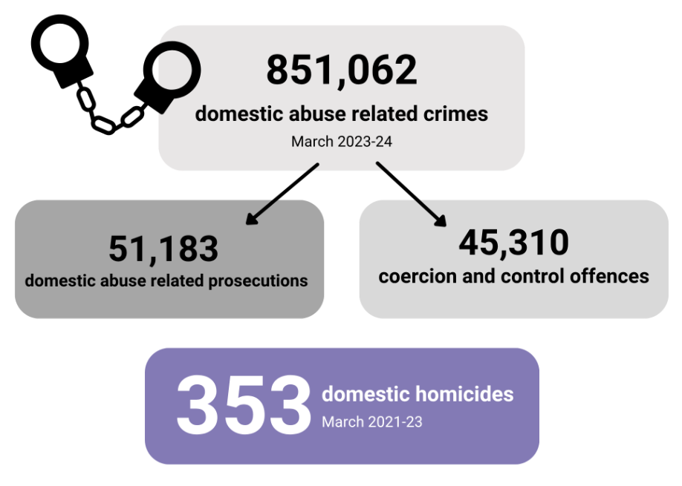
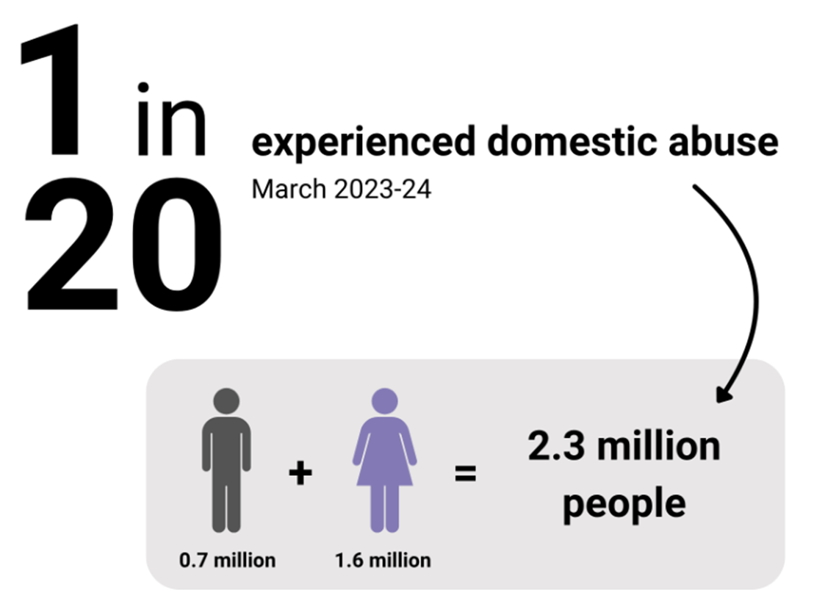
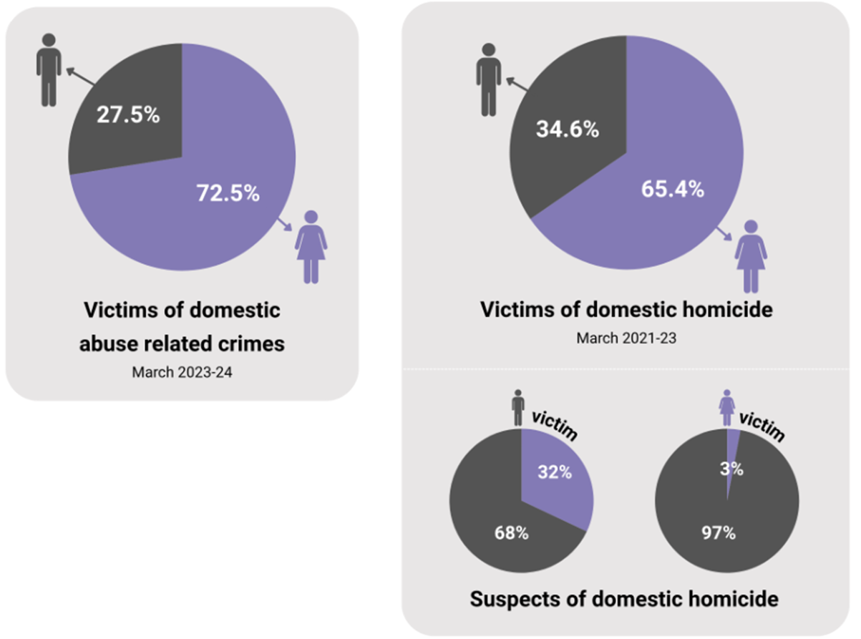
Those aged 16+
Notes:
Those Aged 16+
Approximately 1 in 5 adults experience domestic abuse over their lifetime.
Over the past 15 years, the prevalence of domestic abuse for those aged 16+ in England and Wales has remained around the same percentage.
In England and Wales during the year ending March 2024, approximately 1 in 20 people aged 16+ experienced domestic abuse. That’s an estimated 2.3 million people: 1.6 million women and 0.7 million men.
In England and Wales during the year ending March 2024, the police recorded 851,062 domestic abuse related crimes. This included 45,310 coercion and control offences and resulted in 51,183 domestic abuse related prosecutions. Between the year ending March 2021 and the year ending March 2023, there were 353 domestic homicides recorded by police in England and Wales.
Of the domestic abuse related crimes recorded during the year ending March 2024, 72.5% of victims were female and 27.5% were male. Between March 2021 and March 2023, 65.4% of domestic homicide victims were female. Of the 231 domestic homicides with a female victim, 97% had a male suspect; 74.9% of which were a male partner or ex-partner. Of the 122 domestic homicides with a male victim, 32% had a female suspect.
These statistics show that domestic abuse is a widespread and persistent problem in the UK. Domestic abuse disproportionately affects women and carries serious consequences including a high number of crimes, low prosecution rates, and a troubling rate of domestic homicides. This all highlights an urgent need for stronger prevention, protection, and justice measures.

Slide 20
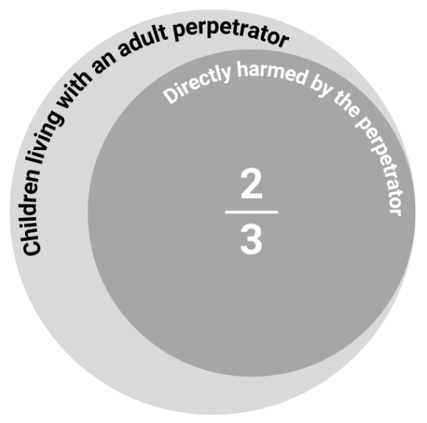
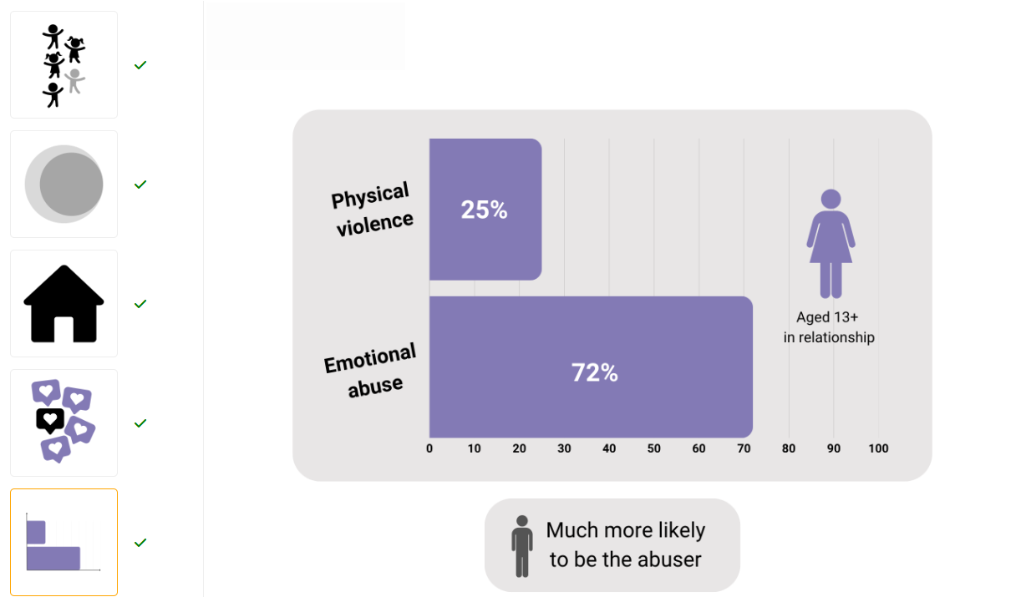
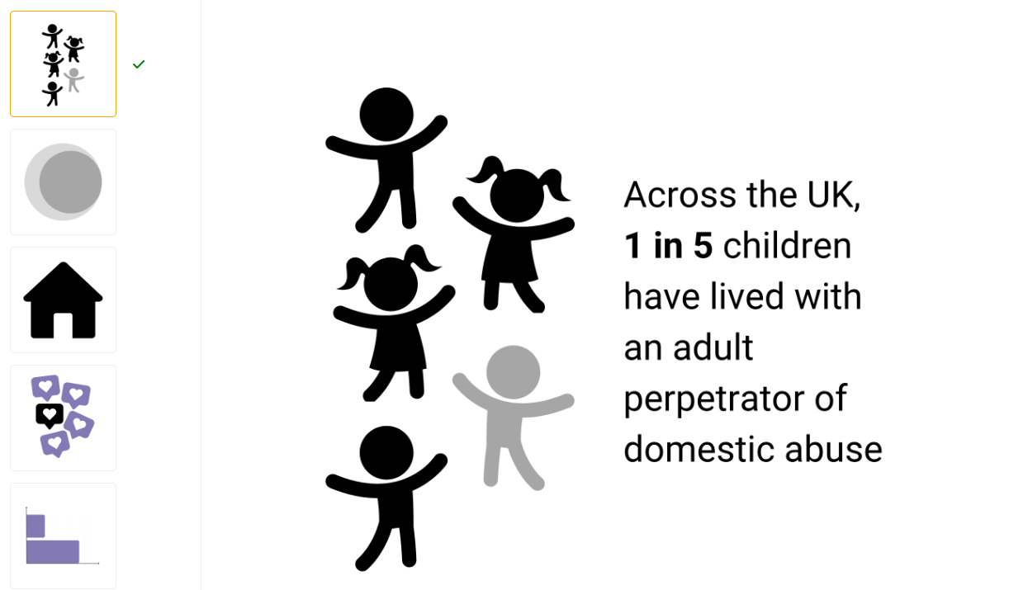
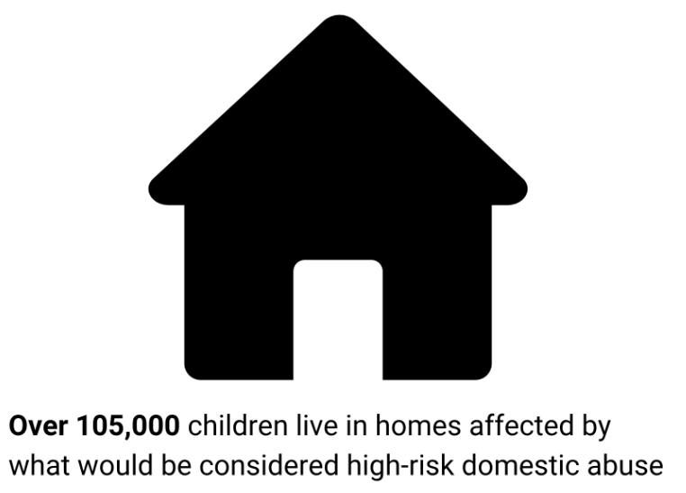
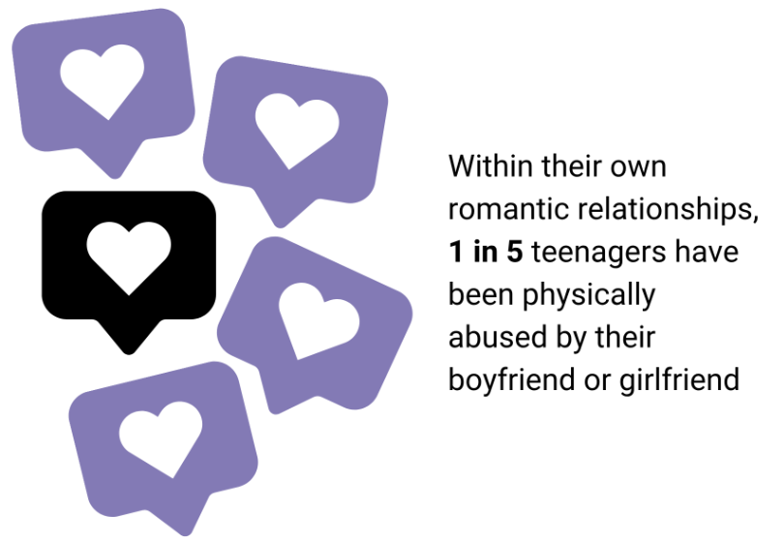
Children and Young People
Notes:
Children and Young People
Across the UK, 20% of children have lived with an adult perpetrator of domestic abuse.
Approximately two-thirds of children living with an adult perpetrator of domestic abuse are directly harmed by the perpetrator, in addition to the harm caused by witnessing the abuse of others.
Over 105,000 children live in homes affected by what would be considered high-risk domestic abuse.
Within their own romantic relationships, 1 in 5 teenagers have been physically abused by their boyfriend or girlfriend.
For young women (aged over 13), 25% experience physical violence and 72% experience emotional abuse within their own romantic relationships. Statistically, boys are much more likely to be the abuser.
These statistics highlight how domestic abuse is a problem that affects children and young people in line with its effect on adults. Domestic abuse has a profound impact on children’s lives, both physically and emotionally. The trauma they experience can affect their mental health, well-being, and future.

Slide 21
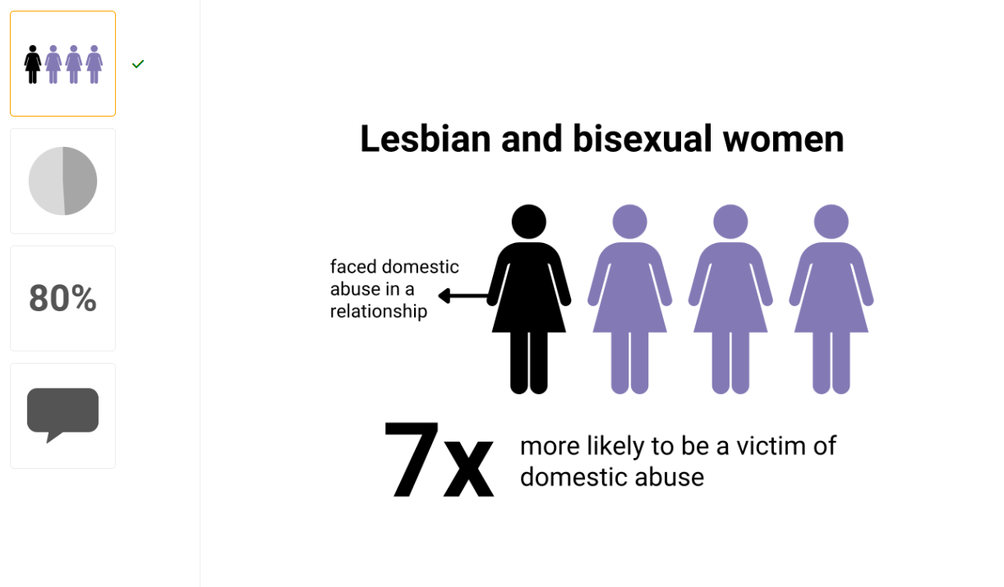
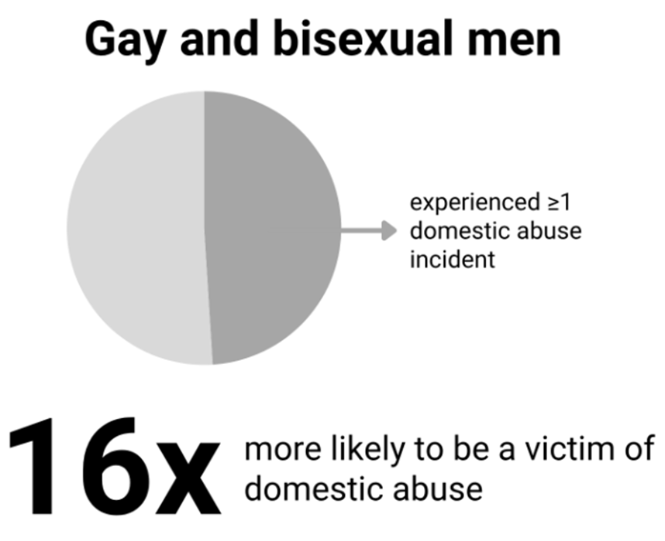
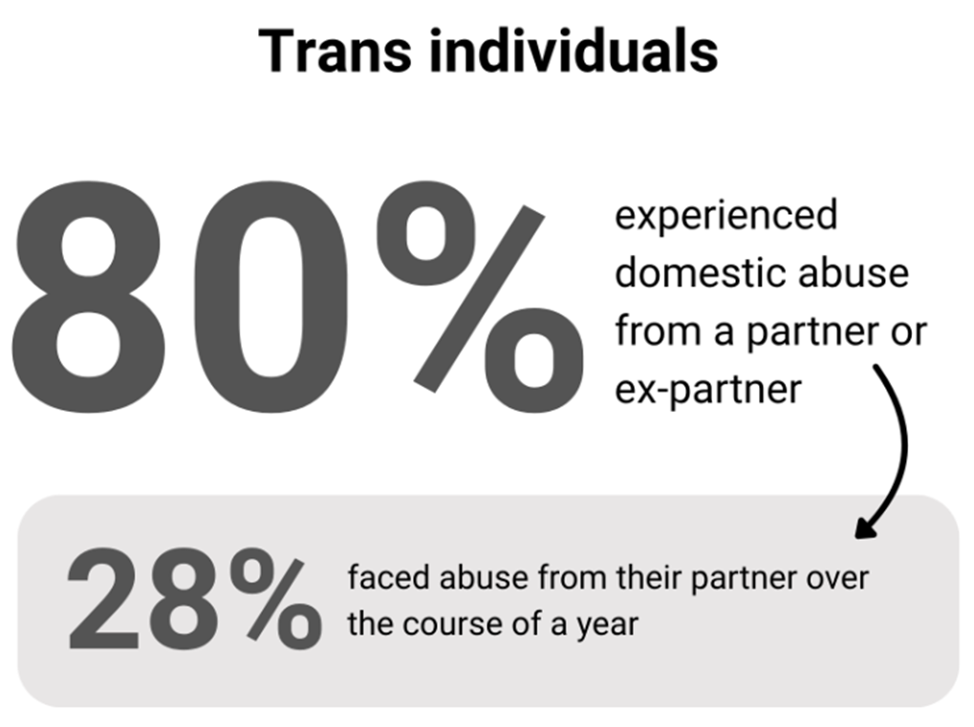
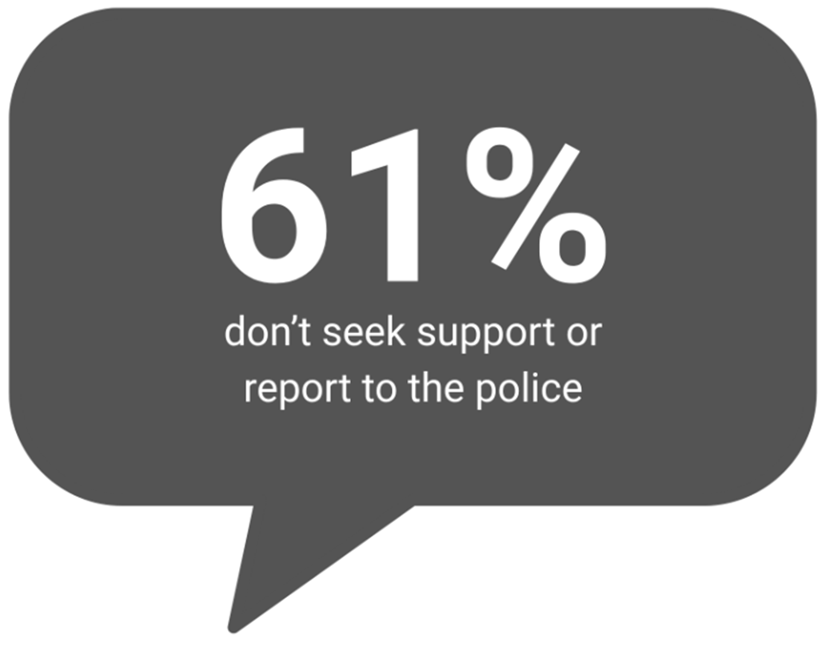
LGBT+ Communities
Notes:
LGBT+ Communities
25% of lesbian and bisexual women have faced domestic abuse in a relationship - which suggests lesbian and bisexual women are approximately 7 times more likely to be the victim of domestic abuse than heterosexual women.
49% of gay and bisexual men have experienced at least one incident of domestic abuse from a family member or partner since the age of 16 - which suggests gay and bisexual men are approximately 16 times more likely to be the victim of domestic abuse than heterosexual men.
One study showed that 80% of trans individuals had experienced domestic abuse from a partner or ex-partner. Another study found that over the course of a year, 28% of trans people in relationships faced abuse from their partner.
Despite these higher than average levels of abuse, one study showed 61% of LGBT+ victims of domestic abuse don’t seek support from services or report the abuse to police.
These statistics suggest that LGBT+ individuals are more likely to experience domestic abuse than those who don't identify as LGBT+. This is important to bear in mind as we seek to support all members of our communities.

Slide 22
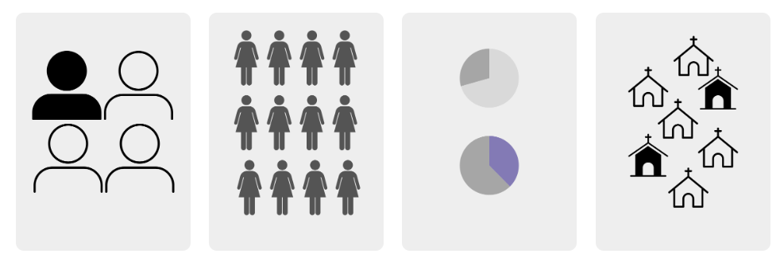
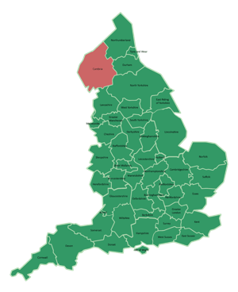
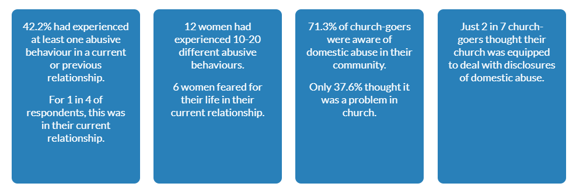
Church Research data - a case study in Cumbria (2018)
Notes:
Church Research data - a case study in Cumbria (2018)
In 2018, researchers surveyed churchgoers and church leaders in Cumbria with the aims to understand the rates, impacts and levels of awareness of domestic abuse as well as to gauge the church’s response and experiences of seeking support.
The ‘Churches Responses to Domestic Abuse’ report highlights the need to recognise that Christian communities are not somehow immune to the experience of domestic abuse. The authors of the report also stress, however, that this data cannot be taken as representative of the country or the church as a whole.
42.2% had experienced at least one abusive behaviour in a current or previous relationship. For 1 in 4 of respondents, this was in their current relationship.
12 women had experienced 10-20 different abusive behaviours. 6 women feared for their life in their current relationship.
71.3% of church-goers were aware of domestic abuse in their community; only 37.6% thought it was a problem in church.
Just 2 in 7 churchgoers thought their church was equipped to deal with disclosures of domestic abuse.

Slide 23

Conclusions
Domestic abuse is a deeply pervasive issue in society, including the church.
No demographic is immune.
Those who are particularly at risk:
Those already marginalised or who hold less power within social structures.
Women, with men more frequently the perpetrators.
Members of the LGBT+ community.
The true scale of domestic abuse remains obscured.
Recognising this hidden crisis is the first step toward addressing it with honesty and compassion.
Notes:
Conclusions to Part 2
Through these broader statistics and more specific surveys, we can see that domestic abuse is a deeply pervasive issue, affecting all corners of society - including the church.
It doesn’t discriminate by age, race, class, or community: no demographic is immune.
There are those who are particularly at risk of experiencing domestic abuse though:
Those already marginalised or who hold less power within social structures.
Women, with men more frequently the perpetrators.
Members of the LGBT+ community.
The true scale of domestic abuse remains obscured, as many cases go unreported due to fear, shame, or lack of support. This means what is visible may only be a fraction of the reality.
Recognising this hidden crisis is the first step toward addressing it with honesty and compassion - both within society and the church.

Slide 24
Review your learning: Part 2 – Question 1 of 3
Which one of the following groups is least likely to experience domestic abuse, based on statistical data?
Choose 1
Men
Transgender individuals
Women
Lesbian and bisexual women
Notes:
Correct answer appears on click

Slide 25
Review your learning: Part 2 – Question 2 of 3
What proportion of children in the UK have lived with an adult who perpetrates domestic abuse?
Choose 1
1 in 10
Half of them
1 in 5
3 in 10
Notes:
Correct answer appears on click

Slide 26
Review your learning: Part 2 – Question 3 of 3
According to Stonewall's surveys, which group is most likely to experience domestic abuse in a relationship?
Choose 1
Gay and bisexual men
Transgender individuals
Lesbian and bisexual women
Heterosexual women
Notes:
Correct answer appears on click

Slide 27
Introduction to Part 3: What are the signs of domestic abuse?
In this part of the course, we aim to raise your awareness of domestic abuse by exploring the signs and patterns in both victims and perpetrators that may indicate that domestic abuse is present.
Notes:
Introduction to Part 3
What are the signs of domestic abuse?
In this part of the course, we aim to raise your awareness of domestic abuse by exploring the signs and patterns in both victims and perpetrators that may indicate that domestic abuse is present.

Slide 28
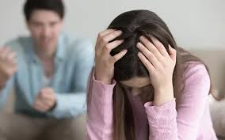
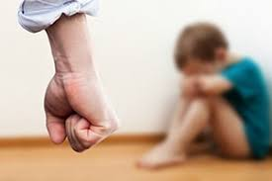


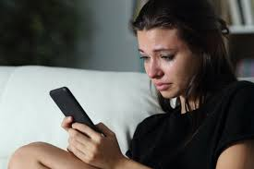
Signs of domestic abuse (victims)
Signs of emotional or psychological abuse.
Signs of physical abuse.
Signs of financial abuse.
Signs of spiritual abuse.
Signs of online abuse.
Notes:
EXERCISE - Signs of domestic abuse
Ask participants to come up with:
Signs of emotional or psychological abuse
Signs of physical abuse
Signs of financial abuse
Signs of spiritual abuse
Signs of online abuse
Signs of emotional or psychological abuse:
Hyper-vigilance/exaggerated startle response
Agitation, anxiety and fearfulness
Wanting to please all the time
Loss of interest in daily activities, work or social life
Changes in sleep (too little or too much)
Developing drug or alcohol or food problems
Self-harm
Avoiding eye contact – ‘cowed’ stance
Very apologetic/meek/indecisive
Low self-esteem / loss of confidence
Symptoms of depression
Talking about/attempting suicide
Signs of physical abuse:
Black eyes
Bruises on arms/inner thigh/unusual places – bilateral/finger marks
Split lips
Red or purple marks on neck
Sprained wrists
Cut/missing hair
Covering up with clothing
Wearing heavy make-up or sunglasses
Unconvincing explanations
Burns
Signs of financial abuse:
Spending someone’s money or property without their consent, or borrowing money and never repaying it
Controlling how much money someone is given, such as giving them a small allowance and making them beg for more
Forbidding someone from having a bank account
Forcing someone to take out a loan, or taking out a loan or credit card in someone’s name and racking up debts or deliberately ruining their credit rating
Squandering or gambling away family resources
Preventing someone from getting a job or education.
Signs of Spiritual Abuse between intimate partners include:
Ridicules or insults the other person’s religious or spiritual beliefs
Prevents the other partner from practicing their religious or spiritual beliefs
Uses their partner’s religious or spiritual beliefs to manipulate or shame them
Forces the children to be raised in a faith that the other partner has not agreed to
Uses religious texts or beliefs to minimise or rationalise abusive behaviours (such as physical, financial, emotional or sexual abuse/marital rape)
Online abuse means the use of digital or online tools to torment someone, for example:
Monitoring or controlling someone’s Social Media accounts
Abusing someone via Social Media accounts
Using spyware or GPS on someone’s phone or computer to track their whereabouts
Revenge porn.

Slide 29


Victims of Forced Marriage, FGM and “Honour based” abuse
Withdrawing from their friends.
Subject to excessive surveillance or control.
Going abroad for long holidays.
Having siblings who were forced to marry or were married very young.
Withdrawal or drastic change in behaviour.
Inability or no permission to make independent decisions.
Reluctance to seek help due to potential repercussions.
Excessive concern with issues of “family honour” or “reputation”.
Often being forced to adhere to strict codes of behaviour, dress, or conduct.
Notes:
Victims of Forced Marriage, FGM and “Honour based” abuse
Some of the indicators that may combine to indicate someone is at risk from these types of abuse include:
Withdrawing from their friends, not returning texts or messages, and disengaging from work or school
Evidence of being subject to excessive surveillance or control
Going abroad on holiday, especially for long periods in the summer or (for children) requiring a long absence from school
Having siblings who were forced to marry or were married very young
Withdrawal or drastic change in behaviour: a sudden withdrawal from social circles, becoming unusually anxious, scared, or depressed, or showing signs of distress when discussing personal matters
Inability or no permission to make independent decisions (e.g., career, relationships, personal choices)
Reluctance to seek help due to potential repercussions, family loyalty, or fear of further harm
Excessive concern with issues of “family honour” or “reputation” and often being forced to adhere to strict codes of behaviour, dress, or conduct.

Slide 30

Signs and impacts of domestic abuse (perpetrators)
Treats partner as a slave/servant.
Puts partner down and uses constant derogatory comments.
Minimises and reduces their own behaviour.
Says their partner has no need to work.
Controls all the money.
Tires victim out by constantly changing their demands.
Doesn’t accept no as an answer.
Stalks victim, keeps a check on everything, isolates victim.
Uses threats and intimidation (to harm or to kill).
Forgets when people are coming over - moans and is verbally abusive.
Notes:
Signs and impacts of domestic abuse (Perpetrators)
Treats partner as slave/servant
Puts partner down and uses constant derogatory comments
Minimises and reduces their own behaviour (e.g. ’only a joke’)
Says they are the 'bread winner' and their partner has no need to work
Controls all the money
Tires victim out by constantly changing their demands as to how to keep them happy
Doesn’t accept no as an answer
Stalks victim, keeps check on everything, isolates victim and is rude to family and friends so they stop coming round
Threats and intimidation (e.g. suicide, taking children away, to kill)
Always forgets when people are coming over, then moans and is verbally abusive when people are invited round

Slide 31
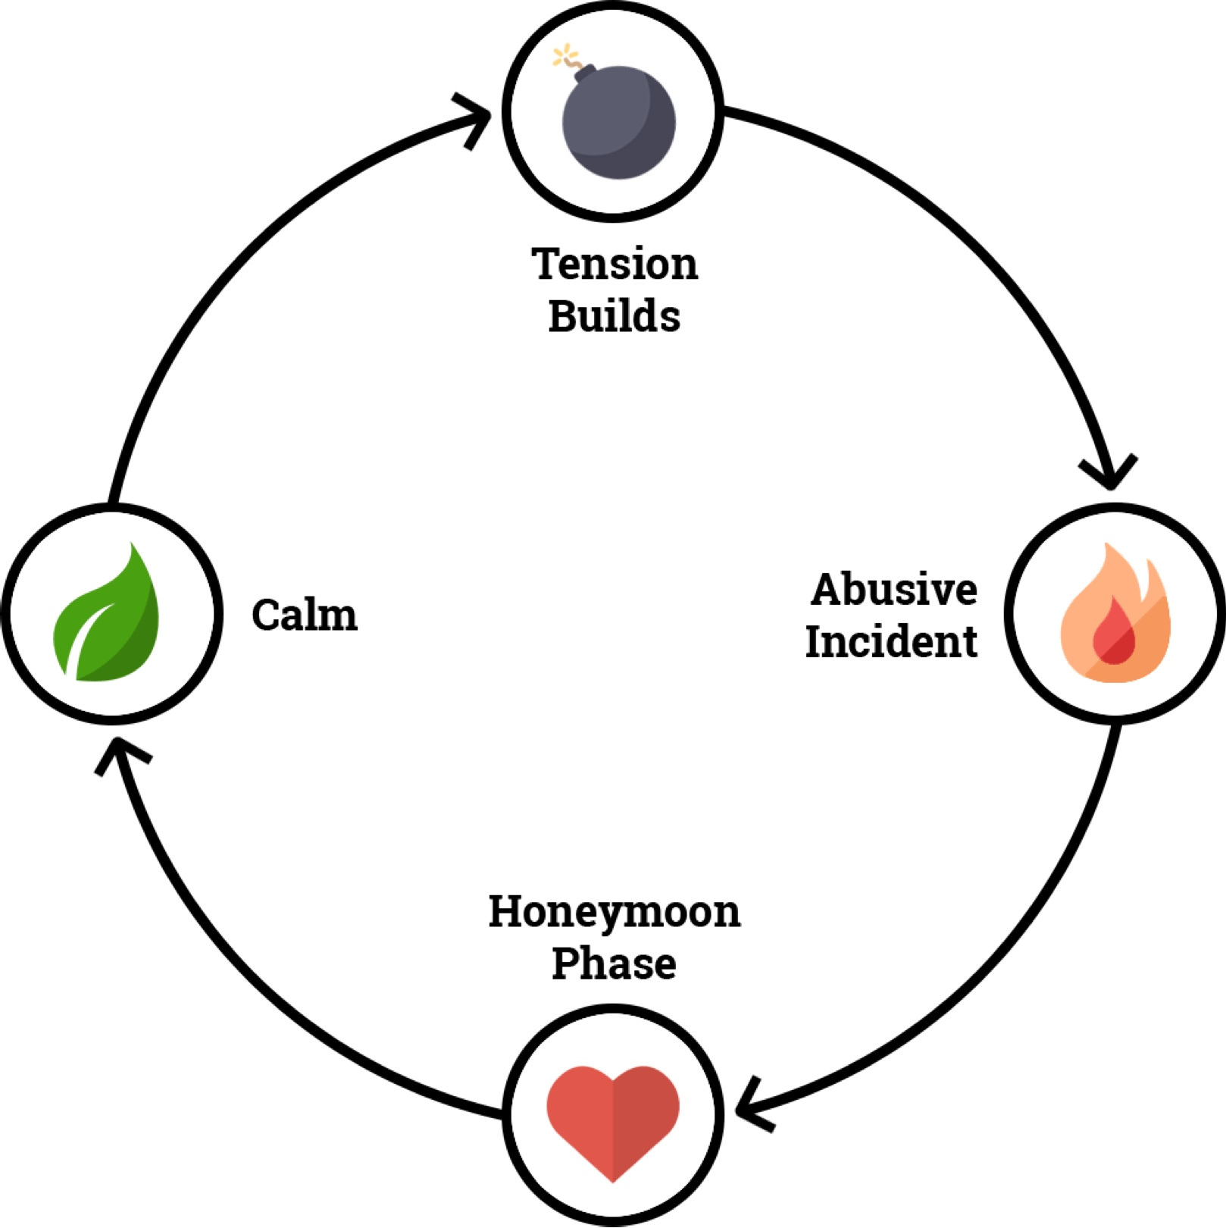
The cycle of abuse
Notes:
The Cycle of Abuse
The Cycle of Abuse in domestic abuse follows a recurring pattern that traps victims in a loop of fear, manipulation, and hopelessness.
It typically begins with the tension-building phase, where stress and strain escalate - arguments, verbal threats, and emotional manipulation create a hostile environment. Victims may feel like they're "walking on eggshells," trying to prevent the situation from boiling over.
This is followed by the abusive incident, where the tension erupts into physical violence, emotional abuse, or sexual assault. This is the most dangerous phase and often leaves the victim traumatised and fearful.
Next comes the honeymoon phase, where the abuser may show remorse, apologise, or promise change. They might be affectionate and attentive, using gifts or emotional appeals to regain control. This phase gives the victim hope that the abuse will stop, deepening emotional ties and making it harder to leave.
Finally, there's a period of calm, where things seem stable, but the underlying issues remain unresolved. Over time, the tension starts to build again, and the cycle repeats.
This predictable yet manipulative cycle can keep victims emotionally entangled and confused, often blaming themselves or believing things will improve - making it incredibly difficult to break free without support.

Slide 32

Gaslighting
Three stages of gaslighting:
The 'Idealisation' stage.
The 'Devaluation' stage.
The 'Discard' stage.
A form of emotional abuse that makes somebody question their beliefs and perception of reality.
It wears down self-esteem and self-confidence, leaving the victim dependent on the person who is gaslighting.
Notes:
Gaslighting
Gaslighting is a term used to describe a form of emotional abuse that makes somebody question their beliefs and perception of reality. Over time, this type of manipulation can wear down self-esteem and self-confidence, leaving the victim dependent on the person who is gaslighting.
The term comes from a 1938 stage play Gas Light in which a husband attempts to convince his wife and others that she is insane. When he dims the gas lights, he insists she's imagining it.
In addition to the signs that someone is experiencing emotional and psychological abuse, those experiencing gaslighting also may:
Believe they can’t do anything right
Have a lingering sense of hopelessness, frustration, or emotional numbness
Be constantly wondering if they’re too sensitive
Believe they’re to blame when things go wrong
Have a persistent sense that something isn’t right, though they can’t identify exactly what’s wrong
Feel disconnected from their sense of self, as if they’re losing their identity
There are three stages to gaslighting in a relationship: idealisation, devaluation and discard.
In the idealisation stage, the victim is whisked off their feet as the ‘gaslighter’ projects an image of themselves as the perfect partner. This resonates with the honeymoon phase of the cycle of abuse.
The devaluation stage hits hard: the victim goes from being adored to being incapable of doing anything right but having tasted the ideal they are desperate to put things right.
Then comes the discard stage where the victim is dropped, ready for the next one. This often happens simultaneously with the idealisation or grooming of the next victim.

Slide 33




The impact on children — ACEs
Whole life impacts
Those exposed to multiple ACEs are at significantly higher risk
Mitigation
The effects of ACEs are not inevitable
Prevention
Plays a key role in preventing ACEs.
ACEs (Adverse Childhood Experiences) are traumatic events that occur in childhood, such as abuse, neglect, or household dysfunction.
This definition also includes domestic abuse; either as a recipient or as a witness.
Notes:
The Impact on Children – ACEs
Adverse Childhood Experiences (ACEs) refer to potentially traumatic events that occur in childhood, such as abuse, neglect, or household dysfunction (for example, parental separation, or substance misuse). This also includes domestic abuse; either as a recipient or as a witness.
These experiences can have a profound and lasting impact on a child's development, health, and wellbeing. It is widely documented that individuals exposed to multiple ACEs are at significantly higher risk for mental health issues, substance abuse, chronic disease, and involvement with the criminal justice system.
ACEs can also impair emotional regulation, learning, and the ability to form healthy relationships. Importantly, the effects of ACEs are not inevitable - early intervention, supportive relationships, and trauma-informed care can help mitigate their impact.
Recognising and addressing ACEs is vital for breaking cycles of trauma and improving long-term outcomes for individuals and communities.
Prevention through education, stable home environments, and access to mental health services plays a key role in reducing the prevalence and effects of ACEs. More information and resources about ACEs can be found at the end of this course.

Slide 34
Review your learning: Part 3 – Question 1 of 3
Which one of the following is a common behaviour exhibited by perpetrators of domestic abuse?
Choose 1
Supporting their partner's career choices
Allowing their partner to manage all financial decisions
Respecting their partner's personal boundaries
Treating their partner as a servant or slave
Notes:
Correct answer appears on click

Slide 35
Review your learning: Part 3 – Question 2 of 3
In the cycle of abuse, which phase follows the abusive incident, where the abuser may show remorse and try to regain control?
Choose 1
The tension-building phase
The honeymoon phase
The calm phase
The escalation phase
Notes:
Correct answer appears on click

Slide 36
Review your learning: Part 3 – Question 3 of 3
Which of the following is a sign that someone may be experiencing gaslighting?
Choose 1
They have a clear sense of their own identity
They feel independent and confident
They are constantly wondering if they are too sensitive
They are able to make decisions without doubt
Notes:
Correct answer appears on click

Slide 37

Time for a break

Slide 38
Introduction to Part 4: Why does domestic abuse happen?
In this part, we explore the reasons why domestic abuse happens, considering insights from the Christian faith and those drawn from social psychology.
We will also reflect on how domestic abuse is handled in Christian communities, and the added complexities for victim/survivors in these settings.
Notes:
Introduction to Part 4
Why does domestic abuse happen?
In this part, we explore the reasons why domestic abuse happens, considering insights from the Christian faith and those drawn from social psychology.
We will also reflect on how domestic abuse is handled in Christian communities, and the added complexities for victim/survivors in these settings.

Slide 39

Fractured images
We are created in the image of God. (Genesis 1:27)
We have an inherent dignity, worth, and the capacity for love, creativity, reason, and moral choice.
This divine image reflects God's character and purpose for humanity.
Human nature has been deeply affected by sin, and this distorts our desires, inclinations, and behaviour. (Genesis 3)
People are capable of great kindness, compassion, and self-sacrifice and also prone to selfishness, pride and violence.
Notes:
Fractured Images
From a Christian perspective, human nature is understood as being created in the image of God (Genesis 1:27).
This imparts inherent dignity, worth, and the capacity for love, creativity, reason, and moral choice.
This divine image reflects God's character and purpose for humanity - to live in relationship with Him and with one another in love and harmony.
However, Christianity also teaches that human nature has been deeply affected by sin, as presented in the Fall of Adam and Eve in the Garden of Eden (Genesis 3).
There is brokenness in the human condition - and this distorts our desires, inclinations, and behaviour.
As a result, human behaviour is marked by a struggle between good and evil. While people are capable of great kindness, compassion, and self-sacrifice, they are also prone to selfishness, pride and violence.
Sadly, this can express itself in destructive patterns like domestic abuse.

Slide 40



Power differences
All forms of abuse involve the misuse or abuse of power.
Power imbalance can arise from finances, education, gender, age, ethnicity, and more.
Power differences can increase or limit a person’s ability to make choices and take action in a situation.
Power differences (e.g. in gender expectations) are often rooted in cultural assumptions, beliefs, and values ('social norms’).
An awareness of power dynamics and cultural assumptions is essential for identifying and understanding domestic abuse.
Notes:
Power Differences
The common thread running through all forms of abuse is the misuse or abuse of power.
Victims of domestic abuse - like victims of other types of abuse - are often those who have less power in a given situation.
These power imbalances can arise from many factors, such as finances, education, gender, age, ethnicity, and more.
This is important on two levels.
First, power differences can increase or limit a person’s ability to make choices and take action in a situation.
Second, power difference (e.g. in gender expectations) are often rooted in cultural assumptions, beliefs, and values.
These ‘social norms’ play a major role in justifying or maintaining the actions of perpetrators and keeping individuals trapped in abusive situations.
Because of this, having an awareness of power dynamics and cultural assumptions is essential for identifying and understanding domestic abuse.

Slide 41

Distorted beliefs and values
Ownership
Reflects the belief that another person is a possession.
Entitlement
Fuels the idea that the abuser deserves special treatment, regardless of
others' needs or boundaries.
Superiority
Reinforces the notion that the abuser is inherently better, smarter, or more important than others.
Notes:
Distorted beliefs and values
Abusive behaviour often stems from deeply rooted core beliefs that distort how individuals perceive themselves and others. Three such beliefs - ownership, entitlement, and superiority - play a significant role in justifying and sustaining abuse.
Ownership reflects the belief that another person is a possession. In relationships, this manifests as control over a partner’s actions, choices, and even thoughts. The abuser may feel justified in monitoring or restricting the victim, viewing them not as an autonomous individual but as someone to manage or command.
Entitlement fuels the idea that the abuser deserves special treatment, regardless of others' needs or boundaries. They may believe they have the right to act out, demand obedience, or be prioritised, even at the expense of others' well-being. When expectations aren’t met, this perceived violation often triggers anger or retaliation.
Superiority reinforces the notion that the abuser is inherently better, smarter, or more important than others. This belief devalues the victim, allowing the abuser to dismiss their feelings, minimise harm, or blame them entirely.
Together, these beliefs create a toxic framework where control and harm are rationalised. Challenging and dismantling these beliefs is essential to ending abuse and fostering respectful, equal relationships.

Slide 42






Domestic abuse within the Christian community
Theological beliefs and cultural norms can both comfort and empower survivors — but also trap them.
Emphasis on marriage, family, and forgiveness can lead survivors to feel shame or guilt about speaking out, fearing they are betraying their faith or community.
Some churches offer false hope that abusive partners will change through spiritual means, which can prolong harmful situations and prevent necessary action.
Scripture is sometimes misused to justify abuse, promoting harmful ideas like unconditional submission or spiritual value in suffering.
Teachings on divorce and re-marriage can deepen survivors’ dilemmas, making them feel morally obligated to stay in unsafe relationships.
Notes:
Domestic Abuse Within the Christian Community
In Christian communities, the experience of domestic abuse can be uniquely complex, shaped by deeply held theological beliefs, cultural norms, and social expectations. While faith can be a source of immense strength and healing, it can also – tragically - be misused in ways that deepen a survivor's suffering and delay their escape from harm.
At the heart of many Christian teachings lies a profound emphasis on the sanctity of marriage, the importance of family, and the virtue of forgiveness. These values, while meaningful in healthy contexts, can inadvertently create an environment where abuse is hidden, minimised, or endured in silence. Survivors may internalise the belief that disclosing their abuse would be a betrayal—not only of their partner, but of their church, their community, and even God. They may feel as if they are “letting the church down” or failing in their spiritual duties, reinforcing a damaging sense of shame and isolation.
In some cases, churches have communicated false or unrealistic hopes that abusive partners will change through prayer, repentance, or counselling. While transformation is always possible, these assurances can trap survivors in cycles of harm, fostering a dangerous optimism that delays necessary action. For many, the pressure to forgive, reconcile, or remain married - no matter the cost - overshadows the reality of ongoing violence and emotional harm.
The misuse of scripture is a particularly harmful element in these dynamics. Christian teachings have, at times, been distorted to give perceived “permission to abuse,” suggesting, for instance, that a wife must submit to her husband unconditionally, or that suffering in marriage is a form of spiritual refinement. These interpretations are not only theologically unsound but profoundly damaging. Faith and scripture can never be used to justify, excuse, or deflect responsibility for abuse - under any circumstances.
Furthermore, the teachings surrounding divorce and re-marriage can intensify a survivor's dilemma. When divorce is framed as a moral or spiritual failure, those experiencing abuse may feel compelled to stay in toxic, dangerous relationships far longer than is safe or necessary. The weight of guilt - combined with fear of judgment or exclusion - can silence survivors and rob them of the support they need most.

Slide 43


Church survivor experiences
After pouring out my heart (it took a long time to summon the courage) the vicar blamed me for the abuse.
The opposite of help - rejection by some who I thought were my closest friends.
The instinct of male ministers seems to be to confront the perpetrator which prompts public denial and private victimisation.
The priest took me back to my husband.
From the outside most people thought we were the perfect happy couple. But I was walking on eggshells in my own home, never knowing what mood they would be in when they came home. It was such a lonely time. I didn’t think anyone would believe me if I told them what it was really like at home. I was desperate for some hope.
After 14 years of abuse, I was told by my priest “It’s a storm in a teacup.”
There was pressure to make marriage work and to sacrifice yourself. After all the church says ‘till death us do part’. I bent over backwards to make it work.
The abuse went on for six years before I realised that what I was experiencing wasn’t just a bad marriage. Everyone says marriage is difficult so at first, I thought it was that – our adjustment to married life.
Notes:
Slide should automatically play audio and advance through the quotes, adding speech balloons as the audio plays (8 balloons).

Slide 44
Review your learning: Part 4 – Question 1 of 3
Which of the following statements help explain how power dynamics relate to domestic abuse?
Choose 3 from the following:
Power differences can come from things like gender, education, or income.
All abuse involves equal power between victim and perpetrator
Physical abuse is easy to detect because it has nothing to do with wider power dynamics.
Society’s rules and expectations can help keep abuse going.
Cultural beliefs can make abuse seem acceptable.
Notes:
Correct answers appear on click

Slide 45
Review your learning: Part 4 – Question 2 of 3
From a Christian perspective, the distorted beliefs and values that abusers hold often arise from the brokenness introduced by sin. How does this relate to an understanding of domestic abuse?
Choose 3 from the following:
People may believe they own others, deserve special treatment, or are better than others.
Sin affects how we love, make moral choices, and see others as made in God’s image.
Harmful cultural norms about power, gender, or status can strengthen wrong beliefs and be used to excuse abuse.
Domestic abuse happens because of money problems or personality clashes, instead of deeper moral or spiritual issues.
Notes:
Correct answers appear on click

Slide 46
Review your learning: Part 4 – Question 3 of 3
Which of the following issues in Christian settings can accidentally support abuse or keep people trapped in abusive relationships?
Choose 4 from the following:
The idea that abusive partners will change through prayer and repentance.
A strong emphasis on the sanctity of marriage, making divorce feel like a spiritual failure.
The idea that suffering in marriage can be a test of faith or spiritual refinement.
A strong focus on the importance of personal responsibility.
The belief that forgiveness always requires reconciliation, regardless of harm.
Notes:
Correct answers appear on click

Slide 47

Why don't people leave abusive relationships?
EMOTIONAL BARRIERS e.g.
Low self-esteem, shame, or trauma bonding.
Self-doubt, love for abuser, hope for change, or fear of threats.
CULTURAL BARRIERS e.g.
Community may discourage separation or divorce.
Victims experience fear of judgement.
PRACTICAL BARRIERS e.g.
Finance, safe housing, or concerns about child custody.
Health issues or being a dependent (being a child or having a disability).
!! INCREASED RISK OF HARM !!
One of the riskiest times for the victim is at the point of leaving the relationship and/or home.
Notes:
Why Don’t People Leave Abusive Relationships
It is not so straightforward as simply leaving an abusive relationship. There are many emotional, cultural, and practical reasons why someone might stay in an abusive situation, and it’s important to approach these situations with empathy and understanding.
Emotionally, the person may struggle with low self-esteem, feel ashamed, or be experiencing trauma bonding—where cycles of abuse and affection create strong emotional ties. Gaslighting may leave them doubting their own reality, making it even harder to recognise the abuse. Love, hope for change, or fear of threats can also keep them from leaving.
Cultural or religious beliefs might discourage separation or divorce, while fear of judgment from family or community can make someone feel trapped.
Practical barriers like financial dependence, lack of safe housing, or concerns about child custody can make leaving feel impossible. Health issues or being a dependent (such as a child or person with a disability) can add another layer of complexity.
Supporting someone in this situation means listening without judgment and being patient, informed, and compassionate.
It is also worth noting that one of the riskiest times for the victim is at the point of leaving the relationship and/or home. Resources and guidance around this can be accessed at the end of the course.

Slide 48
Introduction to Part 5: Domestic abuse scenarios
These scenarios have been developed to provide a taste of the kind of safeguarding situations you might encounter in your role within a parish setting.
Notes:
Introduction to Domestic Abuse Scenarios
These scenarios have been developed to provide a taste of the kind of safeguarding situations you might encounter in your role within a parish setting.
It is not proposed that you would use all scenarios in the training – please pick one or two at the most!

Slide 49

Scenario 1 – David’s story
David, 34, had recently begun attending church. Once sociable, he now avoids events and often seems anxious when checking his phone. He mentions that his partner doesn’t like him staying long after the service or talking to female members of the congregation, and once joked that he has to “get permission” before making any plans. One day, you notice bruises and scratches on his arm, but David brushes it off, saying he’d tripped. He often seems tense when his partner calls, quickly stepping outside to answer.
Take a moment to consider the concerns you might have in this situation.
Think about what your next steps might be.
Notes:
Scenario 1 - David’s Story – For Group Discussion
David, 34, had recently begun attending church. Once sociable, he now avoids events and often seems anxious when checking his phone. He mentions that his partner doesn’t like him staying long after the service or talking to female members of the congregation and once joked that he has to “get permission” before making any plans. One day, you notice bruises and scratches on his arm, but David brushes it off, saying he’d tripped. He often seems tense when his partner calls, quickly stepping outside to answer.
Click 1 - Take a moment to consider the concerns you might have in this situation.
It would be reasonable to be concerned about the following:
David may be experiencing coercive control and emotional abuse, particularly through isolation, monitoring, and restrictions on his behaviour.
Whilst David hasn’t made any formal complaint or said anything serious, comments like “I have to get permission” may be a disguised cry for help or a way of minimising distress - particularly when combined with the other changes you have noticed.
Physical signs such as bruises and scratches could indicate physical abuse, regardless of David’s attempts to downplay them.
It would be wrong to assume that because David is male that this can't be domestic abuse - something which can affect anyone, regardless of gender, age, or sexual orientation.
Whilst there may be a perfectly valid explanations for David's behaviour, that aren't related to domestic abuse, the behavioural changes are still a cause for concern.
Click 2 - Think about what your next steps might be.
You should speak with the Parish Safeguarding Officer (or equivalent) about the situation - they will be able to assess it appropriately and take further steps as necessary.
If you already have a good relationship with him, you could also ask David how he was doing, and mention that you had noticed that he seemed more anxious than usual. Whilst you shouldn't ask questions with the aim of drawing out further safeguarding information, if this is done with care and sensitivity, it can provide an opportunity to share more if he wants to.
It would be inappropriate to ask David directly if his partner is hurting him and suggest he leave the relationship - confronting somebody with direct questions about abuse can cause distress, denial, or fear of consequences.
It would also be wrong to assume that, because he hasn’t asked for help or admitted a problem, he was managing things privately and could continue to do so. It is often difficult for men to seek help or acknowledge that they are struggling. There is cause for concern in this situation and that concern should be taken seriously.

Slide 50

(Church Leadership) Scenario 2 – Maria’s story
Your vicar, Tom, is well-respected in his community—charismatic, devoted, and always present for his congregation. But his wife, Maria, has become increasingly withdrawn. She rarely attends services anymore and often appears flustered when others try to speak with her. Friends have noticed that she never makes decisions without checking with Tom first and seems nervous when he is nearby. A neighbour mentions they often overhear raised voices through the walls—Tom speaking sharply, and Maria apologising repeatedly. Whenever you’ve asked how she’s doing, Maria offers a tight smile and says, “I’m so blessed,” before quickly changing the subject.
Take a moment to consider the concerns you might have in this situation.
Think about what your next steps might be.
Notes:
Scenario 2 - Maria’s Story - For Group Discussion
Your vicar, Tom, is well-respected in his community - charismatic, devoted, and always present for his congregation. But his wife, Maria, has become increasingly withdrawn. She rarely attends services anymore and often appears flustered when others try to speak with her. Friends have noticed that she never makes decisions without checking with Tom first and seems nervous when he is nearby. A neighbour mentions they often overhear raised voices through the walls - Tom speaking sharply, and Maria apologising repeatedly. Whenever you’ve asked how she’s doing, Maria offers a tight smile and says, “I’m so blessed,” before quickly changing the subject.
Click 1 - Take a moment to consider the concerns you might have in this situation.
It would be reasonable to be concerned about the following:
Maria’s withdrawn behaviour, dependence on Tom for decisions, and anxiety in his presence indicate that she may be at risk of emotional or psychological abuse, and possibly coercive control, which falls within the definition of domestic abuse
The pattern of overheard verbal aggression and Maria’s repeated apologising suggest a power imbalance and possible emotional intimidation.
Whilst there may be no direct evidence of harm, Tom’s position of power in the community may make it harder for Maria to speak up or for others to believe her.
Regardless of the words Maria uses when she says she is "blessed", the tension in her expression, and changing the subject suggest that she is uncomfortable and defensive about her true feelings. When someone uses religious language to mask distress, it may be a way of deflecting or avoiding disclosure due to fear or pressure.
It would be wrong to disregard this as a private matter for Maria and Tom, or to just consider it to be evidence of friction caused by Tom prioritising his congregation over his marriage. There is a clear cause for concern.
Click 2 - Think about what your next steps might be.
You should raise your concerns directly with the Parish Safeguarding Officer (or equivalent) - they are trained to assess risk, document concerns properly, and involve other professionals, if necessary, for example the Diocesan Safeguarding team.
You should not talk to Tom about this, or bring up "what the neighbours are saying" with either Tom or Maria. Confronting Tom could risk endangering Maria, as could asking her to make a disclosure (if she was being controlled and monitored).
Even if you could arrange privacy, you shouldn't investigate further by questioning Maria about the situation, looking for proof. You do not need proof of abuse to raise a concern - patterns of behaviour and unease are enough.

Slide 51

(Church Leadership) Scenario 3 – Marks’s story
Mark and Linda had long been a steady presence on the church’s hospitality team—warm and reliable. However, recently, Mark had begun forgetting small tasks, misplacing supplies, or repeating the same questions during meetings. At first, Linda gently corrected him, but over time, her tone grew sharper. “We’ve already gone over this, Mark,” she snapped during a team meeting, her voice tight with frustration. She started doing things herself rather than let him help, often rolling her eyes in front of others and telling others how ‘useless’ he is. Some team members noticed Mark becoming quieter, even confused.
Take a moment to consider the concerns you might have in this situation.
Think about what your next steps might be.
Notes:
Scenario 3 - Mark’s Story - For Group Discussion
Mark and Linda had long been a steady presence on the church’s hospitality team—warm and reliable. However, recently, Mark had begun forgetting small tasks, misplacing supplies, or repeating the same questions during meetings. At first, Linda gently corrected him, but over time, her tone grew sharper. “We’ve already gone over this, Mark,” she snapped during a team meeting, her voice tight with frustration. She started doing things herself rather than let him help, often rolling her eyes in front of others and telling others how ‘useless’ he is. Some team members noticed Mark becoming quieter, even confused.
Click 1 -Take a moment to consider the concerns you might have in this situation.
It would be reasonable to be concerned about the following:
Mark may be experiencing emotional and psychological abuse from his partner, including belittling, controlling behaviour, and public humiliation, especially given Linda’s increasingly demeaning public behaviour - this may constitute domestic abuse.
Mark may be developing cognitive problems that explain this situation. This also may leave him more vulnerable to abuse or neglect.
Whilst Mark's capacity has changed and his behaviour might be frustrating, it seems that Linda may not recognise that both of them need support and care, and that she is reacting badly to a stressful situation.
It would be wrong to consider this a private matter for the couple alone - this is still a safeguarding concern. Marital relationships, even long-standing ones, can be a context where abusive behaviour emerges.
Click 2 - Think about what your next steps might be.
You should speak to the Safeguarding Officer, who can provide guidance, assess whether Mark is at risk, and decide if additional steps (such as referral to adult social care or mental health services) are needed.
If you had a good relationship with Mark, you could arrange to meet with him informally and ask how he is doing. You would need to be careful not to pry, accuse, or try to convince him of what he needs to do (for example, visit a GP should he mention that his memory is failing). If Mark is vulnerable, he may be easily confused or influenced.
Whilst it might improve the performance and morale of the team, asking the church leadership to remove Mark and Lynda from the welcome team would not help their situation - you would also be advocating depriving them of the opportunity to serve, which would be a great loss to both of them.
You should avoid confronting Lynda directly - this could escalate tensions and is not your responsibility as a team member.
You should also avoid discussing this with other team members to see if they’ve noticed anything similar and asking what they think is going on. This could easily into gossip or a breach of confidentiality. It is not part of your responsibility to investigate.

Slide 52
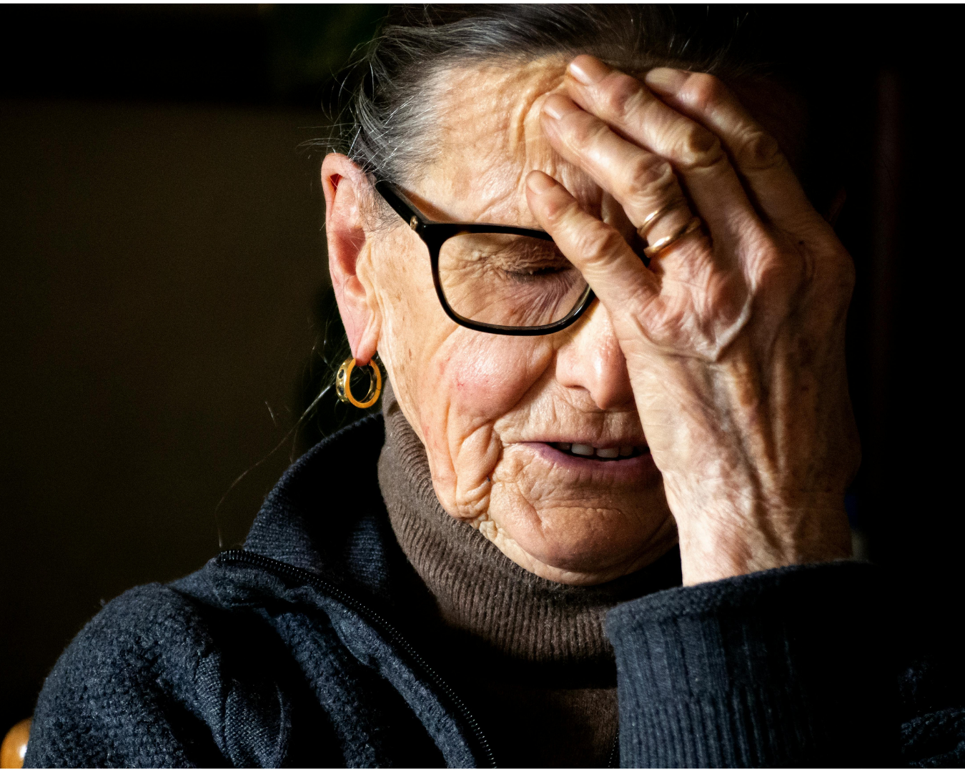
(Community) Scenario 4 – Margaret’s story
78-year-old Margaret has attended your local parish church for many years. She also lives three doors down from you, so you occasionally bump into each other on the street or in the local shop. One sunny morning, you see her sitting in her front garden as you walk past. After waving hello, she calls you in to speak with her. She is clearly upset and explains that her son’s problem with alcohol has worsened. She says that he arrives unannounced to her home and begs for money. She does not want to give it to him but she is afraid to say no. The last time she tried to refuse, he started yelling and screaming at her. He then threw a mug of hot coffee at her. Margaret says she would like things to change, but kept repeating “he is my only son”.
Take a moment to consider the concerns you might have in this situation.
Think about what your next steps might be.
Notes:
Scenario 4 - Margaret’s Story - For Group Discussion
Margaret has attended your local parish church for many years. She also lives three doors down from you, so you occasionally bump into each other on the street or in the local shop. One sunny morning, you see her sitting in her front garden as you walk past. After waving hello, she calls you in to speak with her. She is clearly upset and explains that her son’s problem with alcohol has worsened. She says that he arrives unannounced to her home and begs for money. She does not want to give it to him, but she is afraid to say no. The last time she tried to refuse, he started yelling and screaming at her. He then threw a mug of hot coffee at her. Margaret says she would like things to change but kept repeating “he is my only son”.
Click 1 - Take a moment to consider the concerns you might have in this situation.
It would be reasonable to be concerned about the following:
Margaret is unhappy with the situation and has indicated that she would like things to change.
There is evidence of possible physical abuse.
There is evidence of possible financial abuse.
There is evidence of possible emotional abuse.
Margaret appears to be at risk of further harm.
The various abuses in the above list would constitute domestic abuse in this instance, since the definition of domestic abuse includes any situation where a somebody over the age of sixteen is subjecting another family member over the age of sixteen (including a parent or guardian) to abuse.
Click 2 - Think about what your next steps might be.
You should involve the Safeguarding Officer, who will be able to provide further advice and guidance, and maybe contact any authorities if appropriate.
It would be inappropriate for you to talk to the neighbours, to ask if they know anything more about the situation or how they could be helping Margaret better. This would be considered independent investigation and could risk starting rumours.
You also should avoid talking to Margaret's son to explain that his behaviour is unacceptable - it risks making the situation worse for Margaret, and could put you in harm's way.
It would be an undue escalation of the situation to contact the police directly - especially without Margaret's consent.

Slide 53

(Community) Scenario 5 – Sophia’s story
You are a volunteer on the church's pastoral team and have arranged to meet up with Sophia — a 27-year-old woman with a learning disability who has been attending your church since she was a teenager. She has been living with her partner, Becky, for a couple of years in the local community. Sophia doesn’t have a paid job, but up until a few weeks ago she had been volunteering two or three times per week at various church projects, including the church cafe.
On this occasion, Becky isn't at home when you visit. During the conversation, Sophia gets quite upset and tells you the following:
that she never has enough money to go out;
the reason she never answers her phone and always lets it ring through to the answerphone is that Becky told her not to answer it and that she would sort the phone calls out when she was at home;
that Becky had been angrily dismissive of a recent suggestion that Sophia returns to help …volunteer at the church cafe on Friday afternoons;
and that Becky has taken her bus pass and house keys away from her.
When Sophia sees Becky’s car pull up outside, she becomes extremely agitated and ushers you to the back door, saying, "She can't know you were here.”
Take a moment to consider the concerns you might have in this situation.
Think about what your next steps might be.
Notes:
Scenario 5 - Sophia's story – For Group Discussion
You are a volunteer on the church's pastoral team and have arranged to meet up with Sophia - a 27-year old woman with a learning disability who has been attending your church since she was a teenager. She has been living with her partner, Becky, for a couple of years in the local community. Sophia doesn’t have a paid job, but up until a few weeks ago she had been volunteering two or three times per week at various church projects, including the church cafe.
On this occasion, Becky isn't at home when you visit. During the conversation, Sophia gets quite upset and tells you the following:
that she never has enough money to go out;
the reason she never answers her phone and always lets it ring through to the answerphone is that Becky told her not to answer it and that she would sort the phone calls out when she was at home;
that Becky had been angrily dismissive of a recent suggestion that Sophia returns to help volunteer at the church cafe on Friday afternoons;
and that Becky has taken her bus pass and house keys away from her.
When Sophia sees Becky’s car pull up outside, she becomes extremely agitated and ushers you to the back door, saying, "She can't know you were here.”
Click 1 - Take a moment to consider the concerns you might have in this situation.
It would be reasonable to be concerned about the following:
That Sophia is anxious, unhappy and fearful about her current circumstances. She has lost a lot recently, is in constant pain and is adjusting to new limitations.
That, although it isn't my position to determine whether abuse is occurring, Becky's treatment of Sophia, as related, borders on domestic abuse.
The fact that Sophia has learning disability increases the risk of her being mistreated and not taken seriously.
Although Sophia may feel guilty for not having answered a call, this is not something she has an obligation to do. Telling her to act in a certain way and always answer your calls, particularly when she is trying to keep herself safe, would not be appropriate.
Click 2 - Think about what your next steps might be.
It's a good idea to leave quietly as suggested - reassuring Sophia that her wellbeing is the priority is wise, as she is already feeling bad. It also makes it clear that she hasn’t let you down and you want to support her. Confronting Becky would not be appropriate and is dangerous for both Sophia and yourself. You don’t know how Becky will react, plus it goes against what Sophia wants.
Refusing to leave wouldn’t take Sophia’s wishes into consideration, even if you are concerned about domestic abuse. You have no right to make a decision on Sophia’s behalf and must remember that there are many complex reasons why it isn’t easy to leave a partner when facing domestic abuse.
As you are leaving, it might be helpful to tell her not to worry at all about the volunteering - you don't want to add to the pressures she's already experiencing.
It would definitely be good to ask if there'd be a good time next week for you to come back when Becky wouldn't be around - it's important to maintain positive contact and the combination of Sophia's poor physical health, her learning disability, and the situation with Becky, make it difficult for her to access and engage in social contact outside of the house.
You should also make a note of the conversation and any follow up you have planned and contact the church's Safeguarding Officer within twenty-four hours. They will be able to advise you about an appropriate course of action, and arrange further support for Sophia.
It would be inappropriate for you to investigate further by talking to the neighbours, which isn't one of the responsibilities of a pastoral visitor, or to report the matter to the police, which would be an undue escalation of the situation - especially without Sophia's consent - and since she doesn't appear to be in any immediate danger.

Slide 54
Review your learning: Assessed Scenario - Question 1 of 2
You and an assistant lead a group for children aged six to eight on a Sunday morning during the church service. A boy called Peter comes every week; his parents also regularly attend your church. You are aware that Peter’s mother has recently lost her job. One Sunday you ask the children to make drawings showing their family and things they find important. Peter drew himself with a sad face and what looked like his mum and dad hitting each other. He then started crying and pushed his crayons off the table. The other children begin looking at Peter.
What are your thoughts and concerns? Select all that apply.
Children behave like this all the time; it does not mean that there is domestic abuse within Peter’s family.
One or both of Peter’s parents may be subjecting the other to domestic abuse.
Regardless of whether there is domestic abuse, I need to recognise that Peter is not coping and needs support.
Domestic abuse is not relevant issue in this setting. What is important is that Peter is able to express himself in this way and that’s all I need to focus on. Somebody else will deal with that.
Peter may be subject to, or witnessing, domestic abuse.
Notes:
Correct answers appear on click

Slide 55
Review your learning: Assessed Scenario - Question 2 of 2
What are your next steps? Choose all that apply
Explain to the rest of the children in the group that Peter is upset because his parents are abusing each other.
Take no further action until you’ve discussed this situation with Peter’s parents. As pillars of the church, they deserve to be kept informed and would be angry if they knew you had kept this from them.
Ask an assistant leader to sit with Peter and offer some comfort until the end of the group.
Take Peter out of the group and take him back to his parents so that they can console him.
Report the incident to your Parish Safeguarding Officer within twenty-four hours.
Notes:
Correct answers appear on click

Slide 56
Responding well - learning from scenarios
Recognising when something doesn’t feel right and understanding what our role is—and isn’t—in the situation.
Don't try to investigate or draw our own conclusions.
Always following the proper reporting steps.
Involving the police if someone is at immediate risk of harm.
Being there for the people affected.
Notes:
Responding Well – Learning from the Scenarios
From the scenarios we looked at, some key things stood out.
Firstly, it’s about recognising when something doesn’t feel right and understanding what our role is - and isn’t - in the situation.
We must always remember that in cases where there are concerns about domestic abuse (as with all safeguarding concerns), we shouldn’t try to investigate or draw our own conclusions.
It’s important to follow the proper reporting steps, whether that’s within our organisation or at a regional level, and to reach out for expert advice when needed.
Involving the police is the right call if someone is at immediate risk of harm.
Most importantly, we need to be there for the people affected - offering support and making sure they feel safe and listened to.

Slide 57

Introduction to Part 6: How can we respond to domestic abuse?
Having considered the nature of domestic abuse and how to recognise and respond to it on a case-by-case basis, the final part of this course now focuses on how to address it as a whole church community.
Notes:
Having considered the nature of domestic abuse and how to recognise and respond to it on a case-by-case basis, the final part of this course now focuses on how to address it as a whole church community.
This will include reflections on culture, modelling healthy relationships, and further suggestions of practical action to combat domestic abuse and support those affected by it.

Slide 58
Would you seek help from the church?
Seeking help from the church for domestic abuse:
42.9% Would seek help from the church
42.9% Would not seek help from the church
59.8% Would signpost a friend to the church
24.6% Would not signpost a friend to the church
Reasons why you would not seek help or signpost others:
They would not have the right expertise to help 39.9%
I’d be worried about confidentiality and other people at church finding out 31.7%
I’d be too embarrassed or ashamed 26.4%
It would be wrong to talk negatively about my spouse/partner to someone at church 22.1%
I would feel that it is my duty to make this relationship work 20.2%
They might make things worse 19.7%
There’s no-one that I know or trust well enough 19.2%
I would blame myself for my partners behaviour 11.1%
My partner has a position of responsibility which would make it difficult to confide in others 9.1%
I wouldn’t expect anyone to believe me 9.1%
I’d be worried that what I said might be reported to another organisation 8.7%
I wouldn’t know the signs that I was experiencing domestic abuse 4.8%
Notes:
Would You Seek Help from the Church - Discussion
Take a moment to study the data below from the Cumbria case study (2018) on seeking help from the church for domestic abuse:
42.9% Would seek help from the church
42.9% Would not seek help from the church
59.8% Would signpost a friend to the church
24.6% Would not signpost a friend to the church
Click 1 - Reasons why people would not seek help from the Church or signpost others to Church:
39.9% They would not have the right expertise to help
31.7% I’d be worried about confidentiality and other people at church finding out
26.4% I’d be too embarrassed or ashamed
22.1% It would be wrong to talk negatively about my spouse/partner to someone at church
20.2% I would feel that it is my duty to make this relationship work
19.7% They might make things worse
19.2% There’s no-one that I know or trust well enough
11.1% I would blame myself for my partners behaviour
9.1% My partner has a position of responsibility which would make it difficult to confide in others
9.1% I wouldn’t expect anyone to believe me
8.7% I’d be worried that what I said might be reported to another organisation
4.8% I wouldn’t know the signs that I was experiencing domestic abuse
The picture presented is one that does highlight the need to pay attention to the range of barriers mentioned earlier in this course and the testimony of survivors in the research cited. Whilst this was a regional case study, the findings need to be taken seriously as we reflect on the culture and response as individuals and church communities.

Slide 59

The positive use of power
In Christian communities, power shouldn’t be about control—it should be about serving others.
Jesus used his power to help, heal, include those on the edges, and stand up to injustice.
Make space for others to feel safe, get involved, and grow.
Listening, sharing responsibility, and being open to feedback.
Helps people feel valued, especially those who have been ignored or hurt before.
Right use of power is shown in our actions, and in the kind of community we build.
Notes:
The Positive Use of Power
In Christian communities, power shouldn’t be about control - it should be about serving others, just like Jesus did. He used his power to help, heal, include those on the edges, and stand up to injustice. That kind of power isn’t about being in charge - it’s about love, humility, and lifting others up.
When leaders use power well, they make space for others to feel safe, get involved, and grow.
It means really listening, sharing responsibility, and being open to feedback.
Used in the right way, power can help people feel valued - especially those who’ve been ignored or hurt before.
When our beliefs shape how we lead and treat each other, it makes a real difference.
It’s not just about what we say - it’s about how we act and the kind of community we build.
Using power in a positive, thoughtful way helps create churches that are fairer, kinder, and more healing for everyone.

Slide 60
Practical responses in your church
In governance
Appoint a Parish Safeguarding Officer.
Work with your Diocesan Safeguarding Advisor.
Discuss these issues at PCC or Chapter.
Agree a domestic abuse statement.
Adopt good safeguarding procedures and ensure training is up to date.
Always remember
Cultural sensitivity is key when responding to domestic abuse. It means listening without judgment, respecting different backgrounds - and also be aware of how your own culture may shape your action - or inaction.
Always follow safeguarding procedures, but approach every conversation with empathy, openness, and a willingness to understand the person’s unique context.
In partnerships
Make sure your church knows how to contact their local Domestic Abuse specialist service provider.
Place contact information or leaflets in public places in your building(s).
In learning and discipleship
Include in your youth/children's ministry programme.
Include in adult small group settings.
Financial giving or volunteering.
Notes:
Practical responses in your church
There are lots of simple, practical steps churches can take to respond well to safeguarding and domestic abuse concerns.
In governance, it starts with making sure the right people are in place - appointing a Parish Safeguarding Officer and working closely with your Diocesan Safeguarding Advisor. These conversations shouldn’t be one-offs; they should be part of regular PCC or Chapter discussions. Agreeing a clear domestic abuse statement and keeping safeguarding procedures and training up to date shows that your church takes this seriously.
Partnerships also matter. Make sure your church knows how to contact local domestic abuse services and make that information visible - leaflets or posters in public areas can quietly help someone in need.
And finally, keep it part of your church’s life and learning. These issues can be explored sensitively in youth and children’s work, small groups, and through teaching and prayer. Some may feel called to support this work through giving or volunteering. However you respond, the key is to stay engaged and make your church a place of safety and support.
Remember, cultural sensitivity is key when responding to domestic abuse. It means listening without judgment, respecting different backgrounds - be aware of how your own culture may shape your action - or inaction.
Always follow safeguarding procedures, but approach every conversation with empathy, openness, and a willingness to understand the person’s unique context.

Slide 61
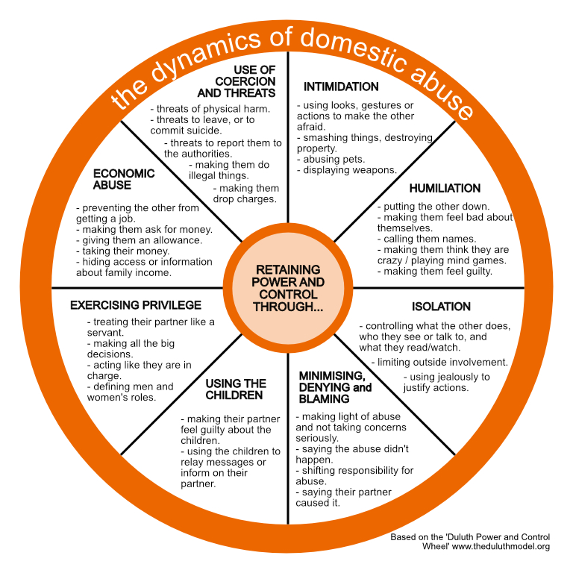
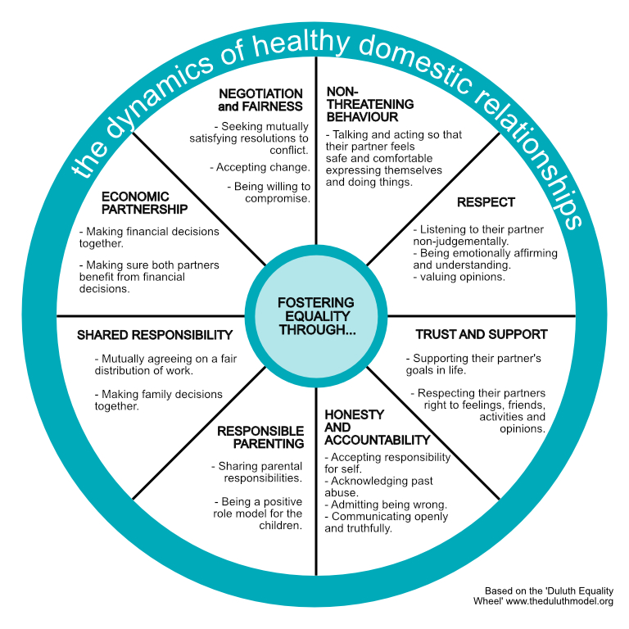
Modelling quality of relationships
Notes:
Modelling Quality of Relationships - Reflection
The ‘Duluth wheel’ was developed as a model to identify different dimensions / dynamics of domestic abuse.
Click
Second version of the wheel replaces the first
Spend a few moments thinking about this image and reflecting on your own community and relationships

Slide 62
Modelling quality of relationships
Notes:
Optional (hidden) slide
This slide is offered as an option to present both wheels alongside each other for comparison

Slide 63


How to respond to disclosure - the 4 R’s
Recognise — Respond — Record — Refer
Recognise
Respond
Record
Refer
Write down, concisely, exactly what is seen, said or heard and make clear where you have added your views or interpretation.
You may find it helpful to use the 4 W’s, as follows:
WHO was involved? Name the key people
WHAT happened? Facts not opinions
WHEN did it happen? Date and time
WHO have you referred the issue on to?
Pass the information to the Safeguarding Lead or Diocesan Safeguarding Advisor in your setting within 24 hours
In case of an emergency call the Police or dial 999.
Accept and take seriously what is being said without displaying shock or disbelief.
Let the person tell their story and don’t push for information or ask leading questions.
Do not interrogate or decide if they are telling the truth.
Be alert to signs and symptoms of abuse.
Reassure the individual they have taken the right step in sharing this information and they are not to blame.
Be honest; never make promises to keep what you are being told confidential. If abuse is involved, you will need to tell someone.
Tell them what you will do with the information they have shared and that they will be kept informed.
Do not introduce personal information or from either your own experience or that of others.
Do not investigate the matter any further for yourself or approach the person about whom allegations may have been made.
Notes:
Click 3 Record
Write down, concisely, exactly what is seen, said or heard and make clear where you have added your views or interpretation. Remember that this is your information, and that you are responsible for passing it on to the person with safeguarding responsibility. Be mindful that your written comments may be needed in the event that further legal or disciplinary action is taken.
WHO was involved? Name the key people.
WHAT happened? Facts not opinions.
WHEN did it happen? Date and time.
WHO have you referred the issue on to?
When recording a second- or third-hand account, it might be helpful to clarify that "what happened" refers not to the alleged incident but to what occurred in your presence - in other words, the date, time and manner in which the issue was reported/disclosed to you. It should not be an attempt to describe the event/situation as if you had witnessed it yourself.
Only pass the information on verbally if it is an emergency situation. Even so, you must also find time as soon as possible to write it down and send it on to the relevant person.
Click 4 Refer
Pass the information to the Safeguarding Lead or Diocesan Safeguarding Advisor in your setting within 24 hours.
In case of an emergency call the Police or dial 999.
How to respond to disclosure - the 4Rs
Click 1 Recognise
Accept and take seriously what is being said, without displaying shock or disbelief.
Let the person tell their story and don’t push for information or ask leading questions.
Do not interrogate or decide if they are telling the truth.
Be alert to signs and symptoms of abuse.
Click 2 Respond
Reassure the individual that they have taken the right step in sharing this information and they are not to blame.
Be honest; never make promises to keep what you are being told confidential. If abuse is involved, you will need to tell someone.
Tell them what you will do with the information they have shared, and that they will be kept informed.
Do not introduce personal information from either your own experience or that of others.
Do not investigate the matter any further for yourself, or approach the person about whom allegations may have been made.

Slide 64

Final Quiz

Slide 65
Final Assessment - Question 1 of 6
What is domestic abuse?
Choose 1
A disagreement between partners
A pattern of behaviour used to gain or maintain power and control over another person
A private family matter that doesn’t require intervention
A mutual conflict between two adults
Notes:
Correct answer appears on click

Slide 66
Final Assessment - Question 2 of 6
Who is affected by domestic abuse?
Choose 2 from the following:
Only people outside of the church community.
People of all genders, ages, races, and socioeconomic backgrounds.
Only women in romantic relationships.
Children who witness or live in homes where abuse is occurring.
Notes:
Correct answers appear on click

Slide 67
Final Assessment - Question 3 of 6
What are signs (or patterns) of domestic abuse?
Select 3 from the following:
Frequent compliments and gifts from a partner
Emotional manipulation or gaslighting.
Controlling behaviour, such as isolating someone from friends/family.
Sudden changes in a person’s behaviour or personality.
Unexplained physical injuries like bruises or broken bones.
Notes:
Correct answers appear on click

Slide 68
Final Assessment - Question 4 of 6
Why does domestic abuse happen?
Choose 2 from the following:
Mental health issues or substance abuse cause domestic abuse.
The abuser wants power and control over the victim.
Learned behaviours from childhood or society.
The victim provokes the abuse.
Notes:
Correct answers appear on click

Slide 69
Final Assessment - Question 5 of 6
Why don't victims/survivors leave relationships with an abuser?
Choose 4 from the following:
They must not think the abuse is serious or harmful.
Fear of further harm or retaliation.
Lack of financial independence or resources.
Hope that the abuser will change.
Concern for children or family stability.
Notes:
Correct answers appear on click

Slide 70
Final Assessment - Question 6 of 6
How can we respond to domestic abuse?
Choose 4 from the following:
Encourage them to leave immediately, regardless of their situation.
Respect the survivor’s decisions, even if they choose to stay for now.
Listen and believe survivors without judgment.
Provide information about support services or hotlines.
Hold abusers accountable and support prevention efforts by reporting to the safeguarding officer / advisor or equivalent in your setting
Notes:
Correct answers appear on click

Slide 71
Summary and Conclusions
In this course we have:
Defined domestic abuse and explored a range of situations that are included in its scope.
Recognised the scale of domestic abuse, who is affected and why it occurs.
Recognised the signs and patterns of domestic abuse, and why removing themselves from abusive relationships is difficult for victims/survivors.
Identified the unique challenges present in Christian communities in engaging with domestic abuse.
Applied a clear process in response to concerns about domestic abuse.
Identified some steps Christian communities can take to respond effectively to domestic abuse.
Notes:
Summary and Conclusions
In this course we have:
Defined domestic abuse and explored a range of situations that are included in its scope.
Recognised the scale of domestic abuse, who is affected and why it occurs.
Recognised the signs and patterns of domestic abuse, and why removing themselves from abusive relationships is difficult for victims/survivors.
Identified the unique challenges present in Christian communities in engaging with domestic abuse.
Applied a clear process in response to concerns about domestic abuse.
Identified some steps Christian communities can take to respond effectively to domestic abuse.

